Slide 1
Node-RED Introduction
Dr. Leon Jololian

Slide 2
Learning Objectives
Introduce some examples of Node-RED: capabilities & concepts
History of Node-RED and its origins
What Node-RED is good for
By the end of this lecture: Understand the Node-RED programming model

Slide 3
What is Node-RED?
Originally, developed by IBM in 2013, as an open source project.
A tool for building Internet of Things (IoT) applications.
It simplifies the ‘wiring together’ of code blocks to carry out tasks.
It uses a visual programming approach that allows developers to connect predefined code blocks, known as ‘nodes’, together to perform a task.
The connected nodes are usually a combination of input nodes, processing nodes and output nodes, which when wired together, make up a ‘flow’.

Slide 4
Install and Run Node-Red
Installation: Use npm to install Node-Red as a global module. It will add the command node-red to the system path:
npm install -g node-red
Starting the Server: In a CMD window, type
node-red
Accessing the application: Enter the following URL in your browser
http://localhost:1880

Slide 5
Node-Red Remote Access
It is possible to access editor from remote machines using the IP of the machine instead of localhost.
FRED is a cloud service that you can sign up with and use Node-RED without having to download and install it. It keeps the instance up to date with the latest code releases and applying bug fixes or patches. Also included is a set of extra Nodes that are contributed by the community, which add to the standard basic set you get when you install Node-RED yourself.

Slide 6
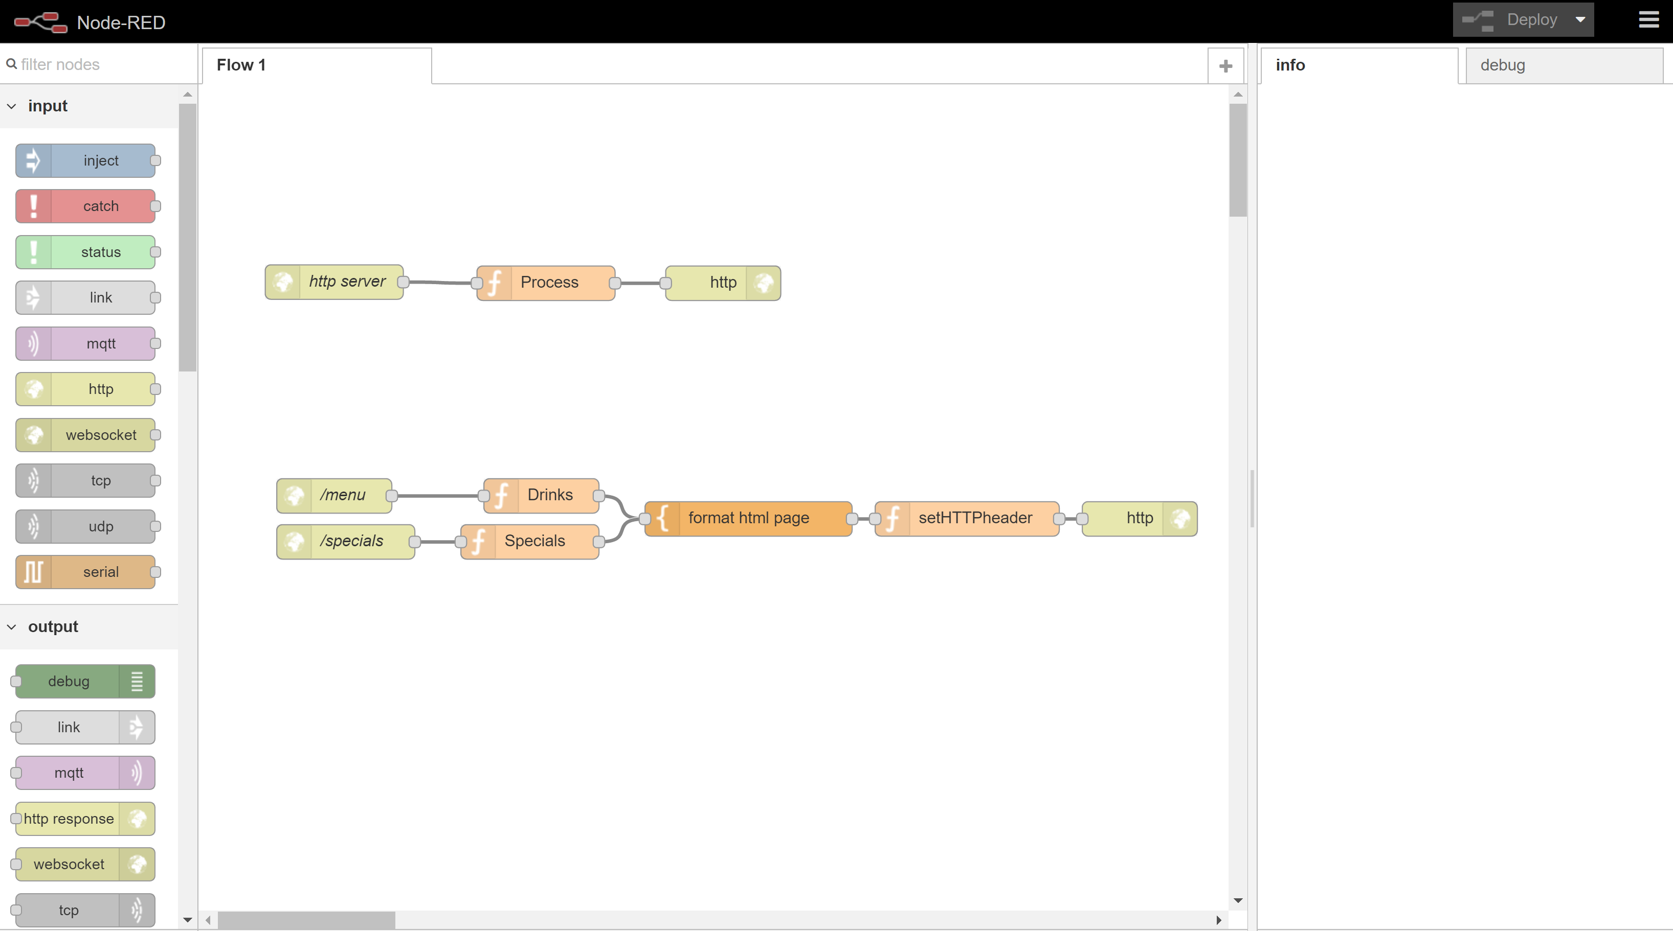
5
2
4
1
3

Slide 7
Elements of the User Interface
Workspace: The main pane (in the middle) is the flow creation area. It is where nodes are dragged, dropped, and connected with wires.
Tabs: located along the top of the workspace pane. Each tab holds a workspace.
Node pane: located on the left and contains all the built-in nodes. Nodes are grouped into categories, input, output, function, etc.
Info and Debug tabs: located on the right-hand side. Info shows documentation for the selected node. Debug shows the output of debug nodes, errors and warnings.
Toolbar: located on the top, right-hand side, are two widgets: a deploy button for executing a flow; and a pulldown menu for admin and control.

Slide 8
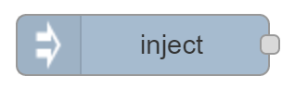
Input Nodes
Input nodes allow you to input data into a Node-RED “flow”. They have at least one output endpoint represented by the small grey square only on their right side. Input nodes are used to connect data from other services, for example the Twitter, Google, serial, websockets, or tcp nodes, or to manually input data into a flow using the inject node.
For example, the inject node:
By pressing the button on the left side of the node allows a message to be injected into the flow.

Slide 9
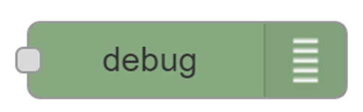
Output Nodes
Output nodes allows for data to be sent outside of a Node-RED flow. They have a single input endpoint on their left side.
Output nodes are used to send data to other services, for example via Twitter, tcp, serial or email nodes, or to use the debug node to output to the debug pane.
For example, the debug node:
can be connected to the output of any node. It can be used to display the output of any message property in the debug tab.

Slide 10
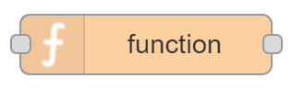
Processing Nodes
Processing nodes allow you to process data. They have an input endpoint and one or more output endpoints.
They allow you to transform the data type (e.g. json, csv, xml) nodes, use the data to trigger a message (e.g. trigger, delay) nodes, and to write custom code that uses the data received (e.g. function node).
For example, the function node:
allows a developer to write code to perform customized tasks.

Slide 11
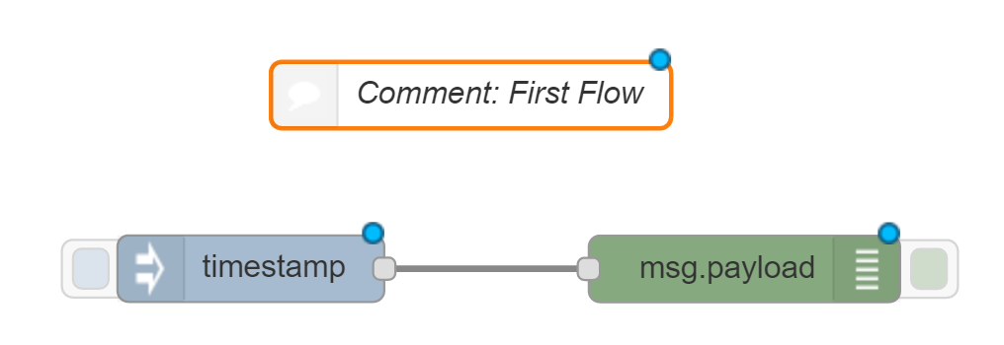
Example #1: Hello, World!
The flow consists of:
A comment node used for documentation purposes (non executable)
An inject node used to inject some information into the flow,
A debug node to which the inject node will be connected. This will allow us to see the output from the flow as a debug message.

Slide 12
Example #2: Show Date
This flow consists of:
An Inject node that creates a time stamp object.
A Function node to create (transform) the time stamp object into a date object
var date = new Date(msg.payload);
msg.payload = date.toString();
return msg;
3. A Debug node that displays the formatted time stamp.

Slide 13
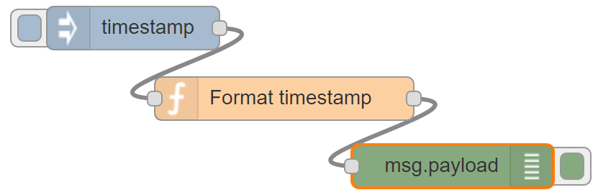
[{"id":"6a9eedb1.1663b4","type":"debug","z":"38990487.924e5c","name":"","active":true,"complete":"payload","x":349,"y":280,"wires":[]},{"id":"e155b862.0f0338","type":"inject","z":"38990487.924e5c","name":"","topic":"","payload":"","payloadType":"date","repeat":"","crontab":"","once":false,"x":127,"y":184,"wires":[["49923a65.841704"]]},{"id":"49923a65.841704","type":"function","z":"38990487.924e5c","name":"Format timestamp","func":"var date = new Date(msg.payload);\nmsg.payload = date.toString();\nreturn msg;","outputs":1,"noerr":0,"x":232,"y":233,"wires":[["6a9eedb1.1663b4"]]}]

Slide 14
Example #3: Web Server
This flow consists of:
An HTTP request node that creates a Web server and route.
A Function node to define the message that will be the response
msg.payload = “Hello, World!”;
return msg;
3. An HTTP response node that sends the response back to the requesting client.

Slide 15
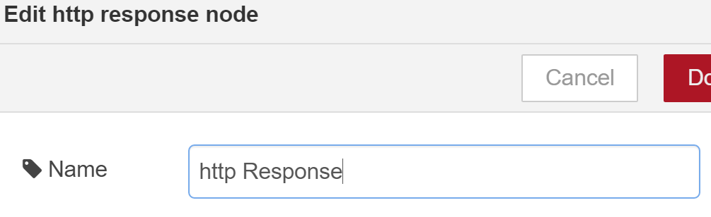
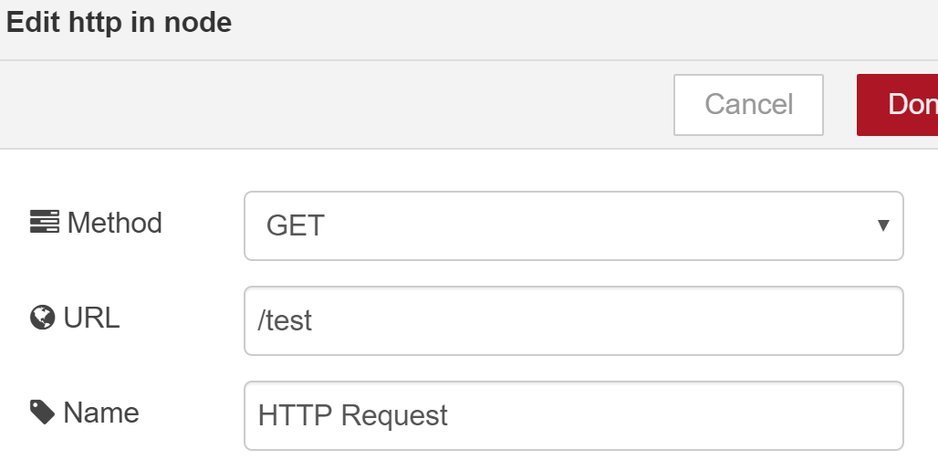
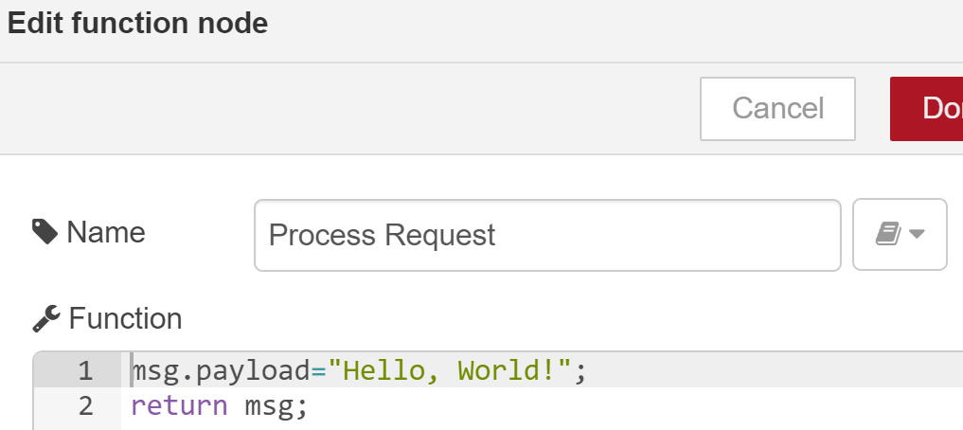
http://localhost:1880/test

Slide 16
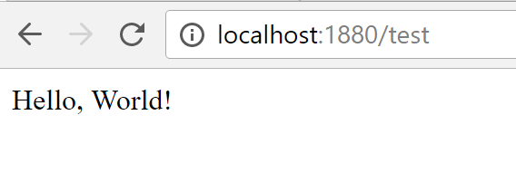
[{"id":"42c83db3.166ee4","type":"http response","z":"a42b3696.f6c1e8","name":"HTTP Response","x":622,"y":244,"wires":[]},{"id":"66929593.345b0c","type":"function","z":"a42b3696.f6c1e8","name":"Process Request","func":"msg.payload=\"Hello, World!\";\nreturn msg;","outputs":1,"noerr":0,"x":392,"y":244.5,"wires":[["42c83db3.166ee4"]]},{"id":"f3d3481d.454ea8","type":"http in","z":"a42b3696.f6c1e8","name":"HTTP Request","url":"/test","method":"get","swaggerDoc":"","x":181,"y":244.5,"wires":[["66929593.345b0c"]]}]

Slide 17
Example #4: Weather Alert
Add the openweathermap the node-red palette
Change to the directory: .node-red
Execute the command: npm install node-red-node-openweathermap
Restart you node-red server
Sign up with the OpenWeatherService by creating a free account:
Go to: http://openweathermap.org/appid
Follow instructions for a new account signup
Get the API key
Configure the new node

Slide 18
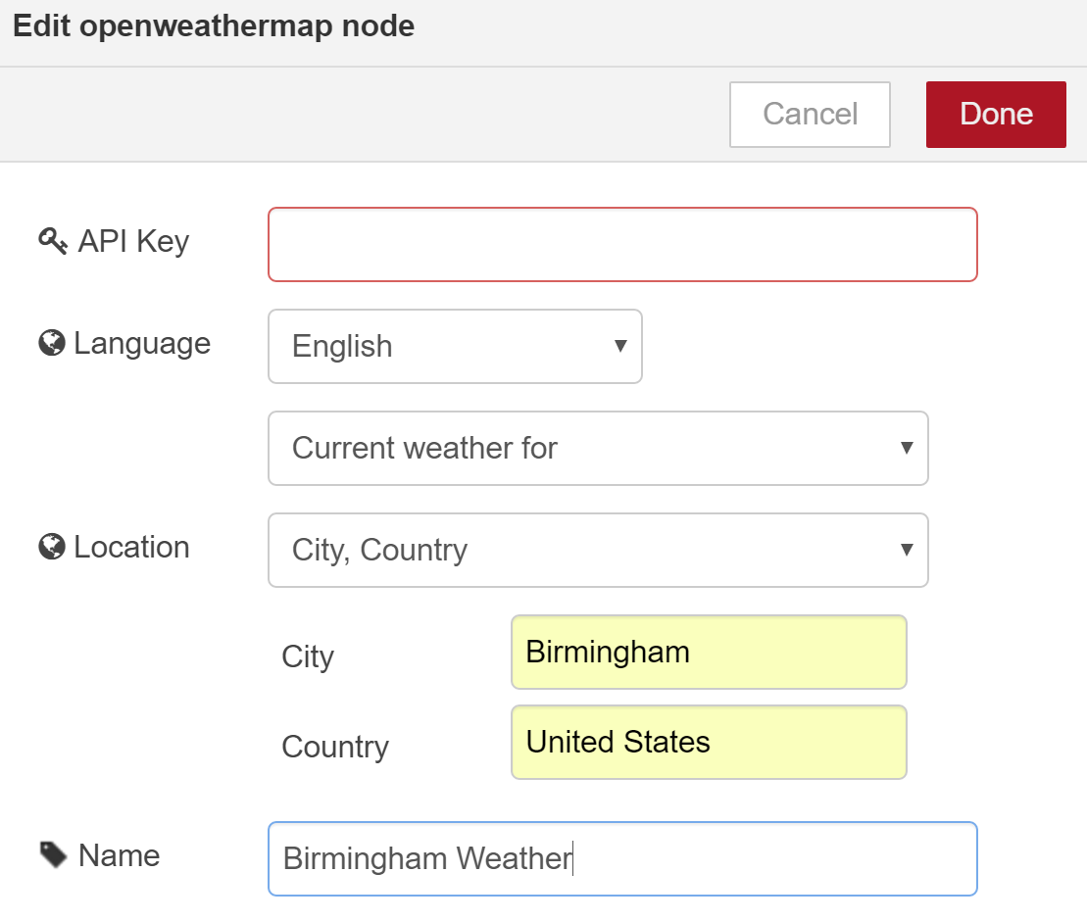
Configuring the openweathermap Node
* Fill in all the fields, including the API Key field

Slide 19
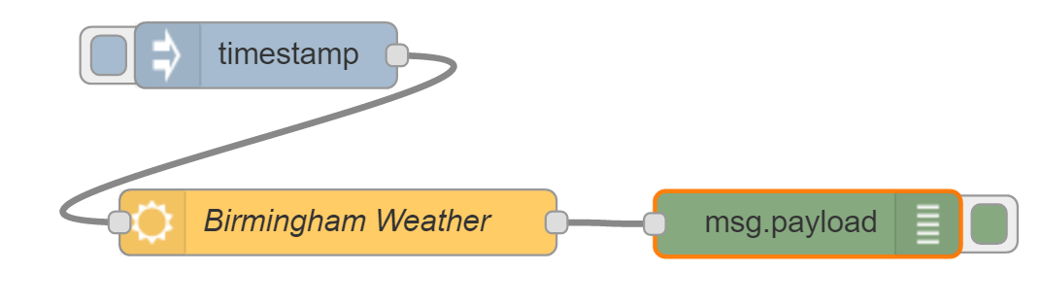
Testing the openweathermap node
Create the following flow:
Click on the timestamp node trigger and observe results in the debug tab of the debug node:
{ "weather": "Clear", "detail": "clear sky", "tempk": 284.86, "tempc": 11.6, "temp_maxc": 12.9, "temp_minc": 10.9, "humidity": 50, "maxtemp": 286.15, "mintemp": 284.15, "windspeed": 2.1, "location": "Birmingham", "sunrise": 1481719451, "sunset": 1481755252, "clouds": 1, "description": "The weather in Birmingham at coordinates: 33.52, -86.8 is Clear (clear sky)." }

Slide 20
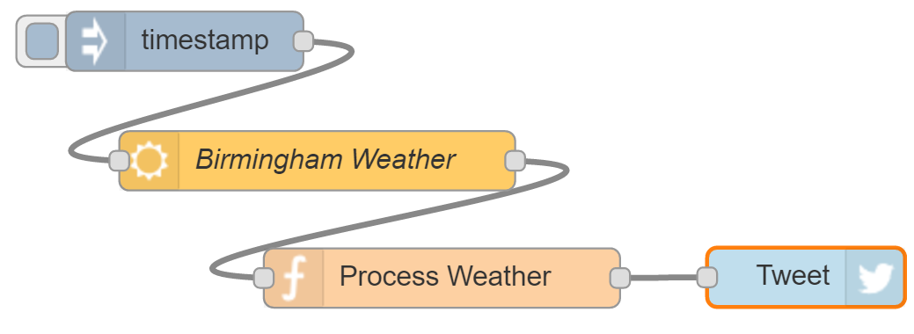
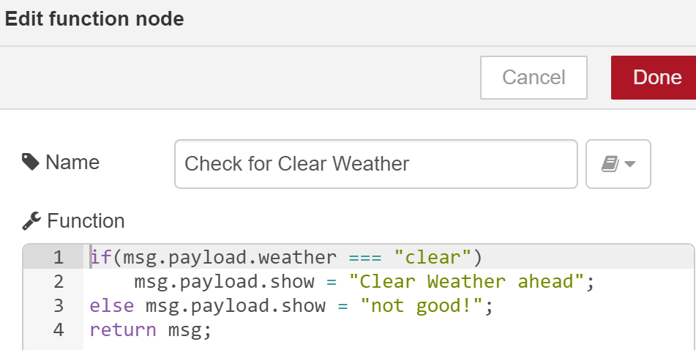

Slide 21
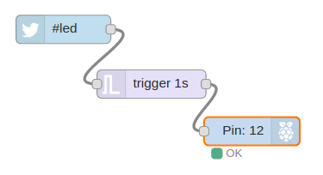
Example #5: Using Twitter to control a Raspberry-Pi
The Node-RED flow checks if a Twitter hashtag #led is detected to turn on a LED connected to a Pi. It consists of 3 nodes wired together – a twitter node on the left, a trigger node in the middle and a Raspberry Pi (gpionode) node on the right.
The nodes, represented by rounded boxes, usually have an icon to represent their type, e.g. the Twitter bird icon in the first node, and a text name that can be set by the programmer.

Slide 22
The Twitter node: a built-in node that hides all of the complexity of using the Twitter API. It can be configured with a user’s account credentials and a variety of search strings, in our case it’s simply looking for hashtag ‘#led’.
The trigger node: a built-in node with a default behavior to wait for any message on its input. Upon receiving a message, it ‘triggers’, and sends a message on its output with the value “1” as the message body. It then waits 1 second and sends a second message with the value “0” in the message body.
The gpio node: a built-in node that hides the details of setting the IO pins on the R-PI. When it gets a message “1” in the body, it takes the IO pin high, and when it receives a message with body of “0”, it takes the pin low. In this example, the gpio node is configured to control pin number 12, and so the node shows that in the node icon.

Slide 23
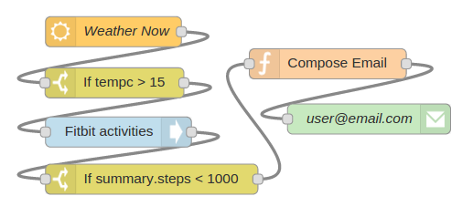
Example #6: Using Node-RED to send alerts when falling behind on exercise schedule

Slide 24
The Weather Now node
The Weather Now (openweathermap.org ) node can be configured to check the weather for any major city at set intervals.
When it checks, it packages up the results in a message which is forwarded to the next node, in this case, to a switch node.
The switch node performs a simple test, checking the input message for a value and sending a message with a value of “1” if the test is true.
In this case, it’s been configured to test the temperature value (tempc) to see if it’s 15 degrees Celsius or higher.

Slide 25
The First Switch and Fitbit Nodes
When the first Switch Node tests to true, or ‘switches on’, it sends a message onto the Fitbit node which is the next node in the flow.
The Fitbit Node is another built-in node that can be configured to get statistics on a Fitbit device from the fitbit.com portal.
The Fitbit Node packages the statistics for your device into a message and forwards it to the next node in the flow.

Slide 26
The Second Switch Node
The Switch Node is configured to check if the number of steps you’ve walked today is less than 1000.
It does this by testing to see if the Fitbit data field, summary.steps, is less than 1000.
Based on the message received from the Fitbit node, which in turn got them by making a call to the Fitbit API on fitbit.com.

Slide 27
The Function Node (Compose Email)
If you have walked less than 1000 steps today, then the Switch Node generates a message that is passed on through the flow to a Function Node (Compose Email).
The Function Node is a generic all-purpose node that allows you to write your own programming logic in JavaScript (To be discussed later). For now, we assume that this node just creates a new message with an email subject line and a text body that can be sent by email.
Once this message is created within the Function Node, it is sent through the flow to the final node which is an email node. This node will take the body of any incoming message and send it to the email account configured when the node is initialized.

Slide 28
Writing Functions
The Function node allows JavaScript code to be run against the messages that are passed in and then return zero or more messages to continue the flow.
The message is passed in as an object called msg.
By convention, it will have a msg.payload property containing the body of the message.
Other nodes may attach their own properties to the message.
If the function returns null, then no message is passed on and the flow ends.

Slide 29
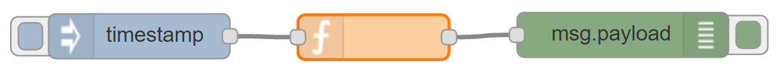
Function Passing Message “as-is”
The most simple function node just returns null. When you return null, no message is passed on to downstream nodes and the flow ends here.
To create a function node that passes the message “as is”, you can simply return the message itself. This is the default code in a function node:
return msg;

Slide 30
What will be generated by the flow on the previous slide if:
1) We replace the code of the function node with the following?
msg.payload += "world";
return msg;
2) We use a string in the inject node with a value of “Hello”, and
the same code as above in the function node?
3) We use the following code in the function node:
var x = { payload: "My new payload" };
return x;

Slide 31
The returned message object does not need to be same object as was passed in.
The function can construct a completely new object before returning it. For example:
var newMsg = { payload: msg.payload.length };
return newMsg;
The function edit dialog allows the number of outputs to be changed. If there is more than one output, an array of messages can be returned by the function to send to the outputs.
This makes it easy to write a function that sends the message to different outputs depending on some condition.
if (msg.topic === "banana") {
return [ null, msg ];
} else {
return [ msg, null ];
}

Slide 32
The following example passes the original message as-is on the first output and one containing the payload length to the second output:
var newMsg = { payload: msg.payload.length };
return [msg, newMsg];
A function can return multiple messages on an output by returning an array of messages within the returned array. When multiple messages are returned for an output, subsequent nodes will receive the messages one at a time in the order they were returned.
In the following example, msg1, msg2, msg3 will be sent to the first output.
msg4 will be sent to the second output.
var msg1 = { payload:"first out of output 1" };
var msg2 = { payload:"second out of output 1" };
var msg3 = { payload:"third out of output 1" };
var msg4 = { payload:"only message from output 2" };
return [ [ msg1, msg2, msg3 ], msg4 ];

Slide 33
The following example splits the received payload into individual words and returns a message for each of the words:
var outputMsgs = [];
var words = msg.payload.split(" ");
for (var w in words) {
outputMsgs.push({payload:words[w]});
}
return [ outputMsgs ];

Slide 34
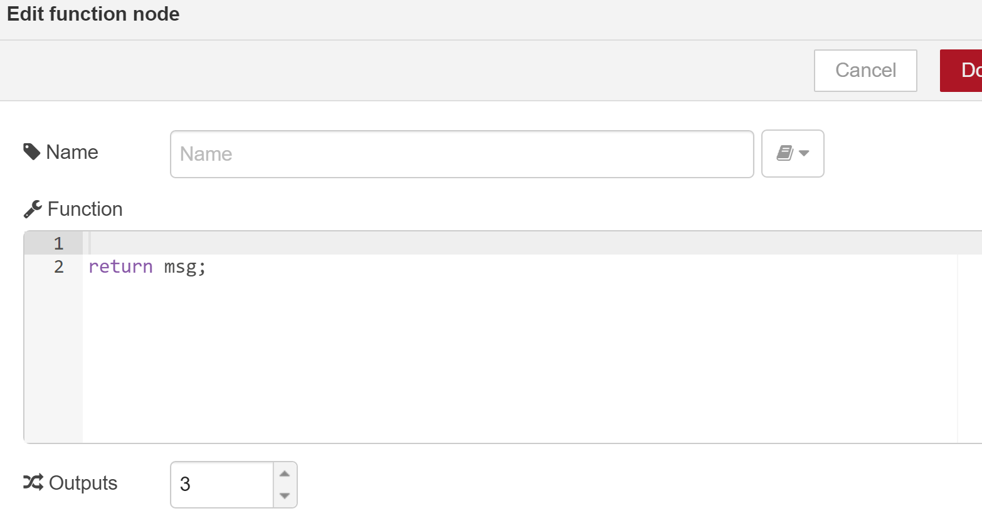
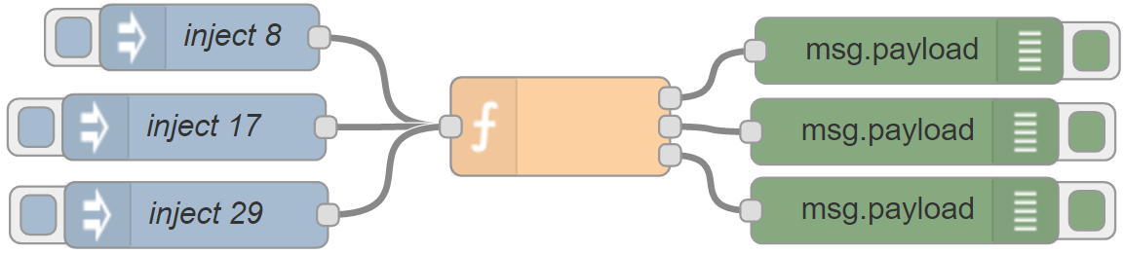
A Function can produce more than one output by simply setting the “output” parameter to the desired number of outputs:
The following code shows how to channel a payload to a particular output:
if(msg.payload < 10) { return [msg, null, null]; }
else if(msg.payload < 20) { return [null, msg, null]; }
else if(msg.payload >= 20) { return [null, null, msg]; }

Slide 35
Sending multiple messages in sequence using a function node
It is also possible to send multiple messages from a function node in sequence by simply returning an array of messages in the output message array.
The following code in the function node will generate 10 new messages with payloads from 0 to 9.
var msgList = [];
for (var i=0; i<10; i++) {
msgList.push({payload:i});
}
return [msgList];

Slide 36
Logging events
If a node needs to log something to the console, it can use one of the following functions:
node.log("Something happened");
node.warn("Something happened you should know about");
node.error("Oh no, something bad happened");
The warn and error messages also get sent to the flow editor debug tab
If the function encounters an error that should halt the current flow, it should return nothing. To trigger a Catch node on the same tab, the function should call node.error with the original message as a second argument:
node.error("hit an error", msg);

Slide 37
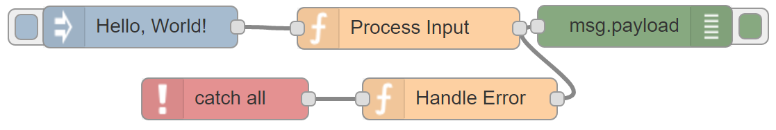
Exception Handling
Process Input:
if(msg.payload == "Hello, World!")
node.error("something went wrong", msg);
Handle Error:
msg.payload = "An unexpected Error has occurred, " + msg.payload
return msg;
When an exception occurs, control is transferred to the “catch” node

Slide 38
Storing Data between Function Invocations
Aside from the msg object, the function can also store data between invocations within it’s context object.
The following example maintains a count of how many times the function has been run:
var count = context.get('count')||0; // initialize counter to 0 if it doesn't exist
count += 1;
context.set('count',count); // store the value back
msg.count = count; // make it part of the outgoing msg object
By default, the context data is not persisted across restarts of Node-RED.

Slide 39
Storing Data in Flow Context
Just as the context object is local to the node, there is also a flow-level context that is shared by all nodes, not just Function nodes, on a given tab. It is accessed via the flow object:
var count = flow.get('count')||0;

Slide 40
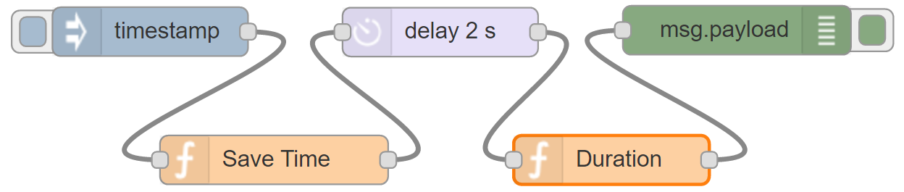
Using Global Context
A global context module is available to share context between function nodes
Flow to calculate the time elapsed for a message to go through the delay node:
context.global.startTime = new Date().getTime();
return msg;
var currentTime = new Date().getTime();
var timeElapsed = (currentTime - context.global.startTime)/1000;
msg.payload = "Time elapsed is: "+timeElapsed+"s";
return msg;

Slide 41
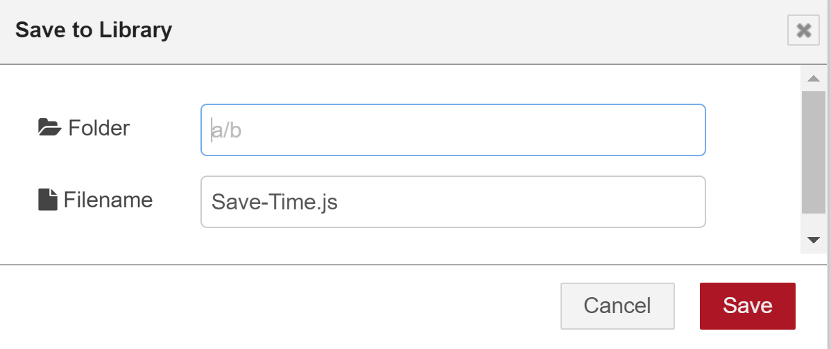
Saving your Function code in a library
To save the code in the function library, click on the Book icon in the function node configuration dialog to the right of the name text edit box, and select “Save to Library”.
To make use of the code you can create a new function node, click on the book icon, then click on “Open Library…” then choose your saved library code.

Slide 42
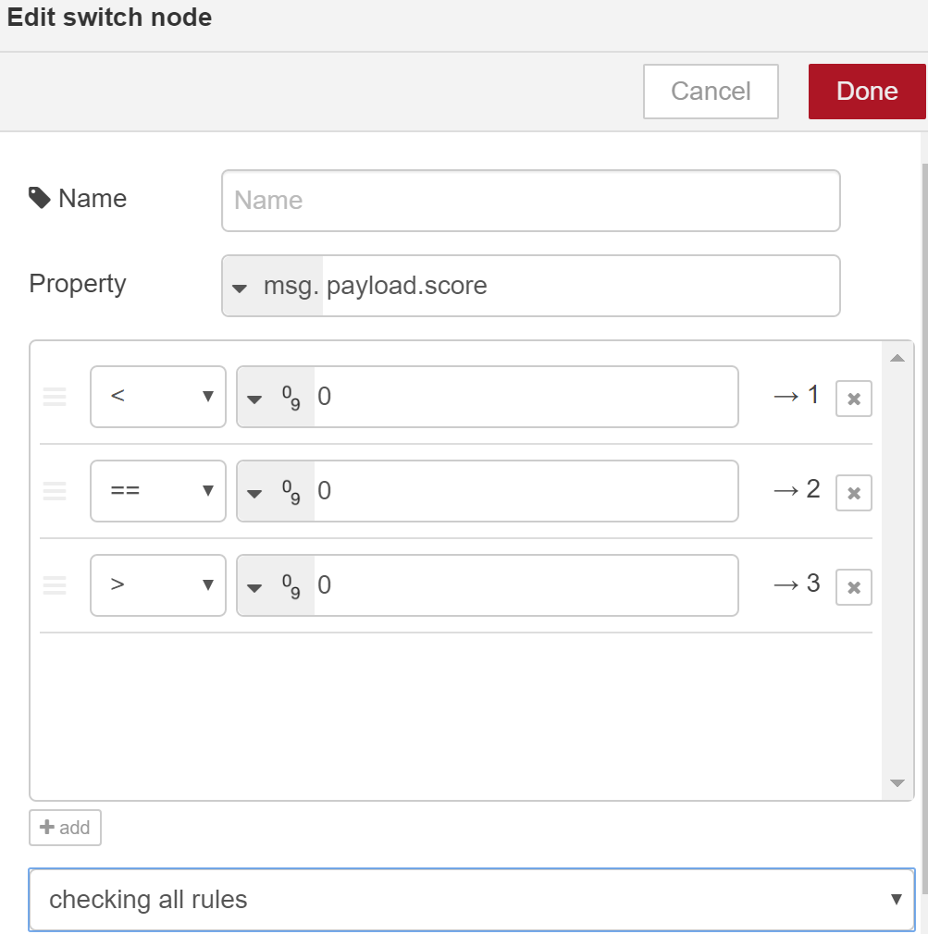
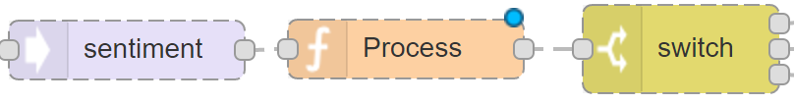
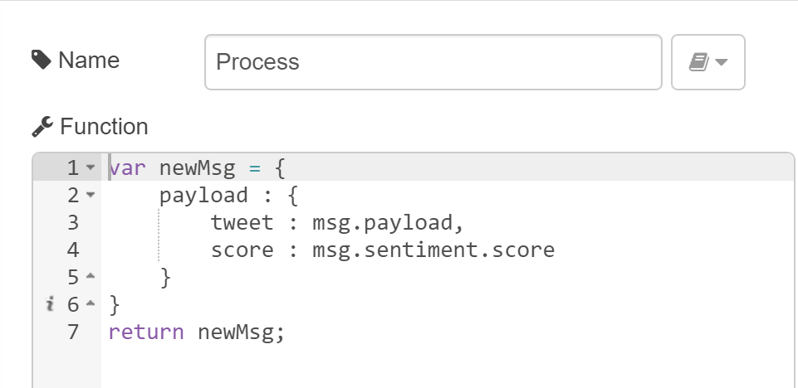
Creating Sub-Flows
A sub-flow that switches outputs depending on the sentiment of messages received.
This can be used to analyze messages from various sources, including Twitter.

Slide 43
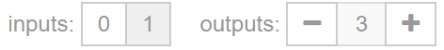
Example:
Create a sub-flow: Menu → Create Subflow.
Wire together a Sentiment analysis, function and Switch nodes.
Configure the switch as shown in the previous slide.
Edit the name of the sub-flow by double-clicking on the tab and changing the name field to Sentiment Switch.
An icon for the new sub-flow will appear in the nodes palette section
Wire an input node to the sentiment and three output nodes to the switch:
Drag the newly created sub-flow from the nodes palette and drop it in a new flow
Double-click on the node and click “edit flow template”
Use the controls to wire the input and outputs

Slide 44
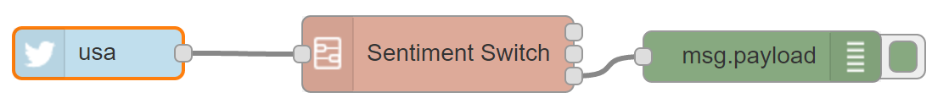
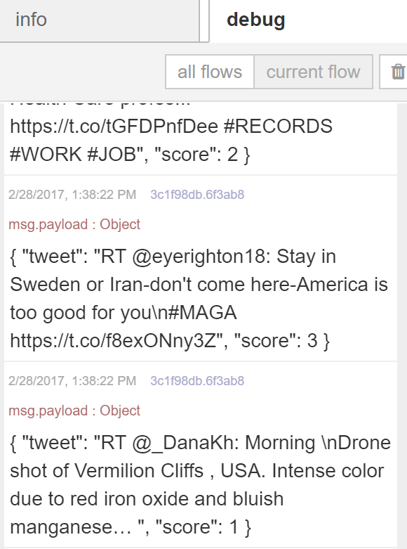
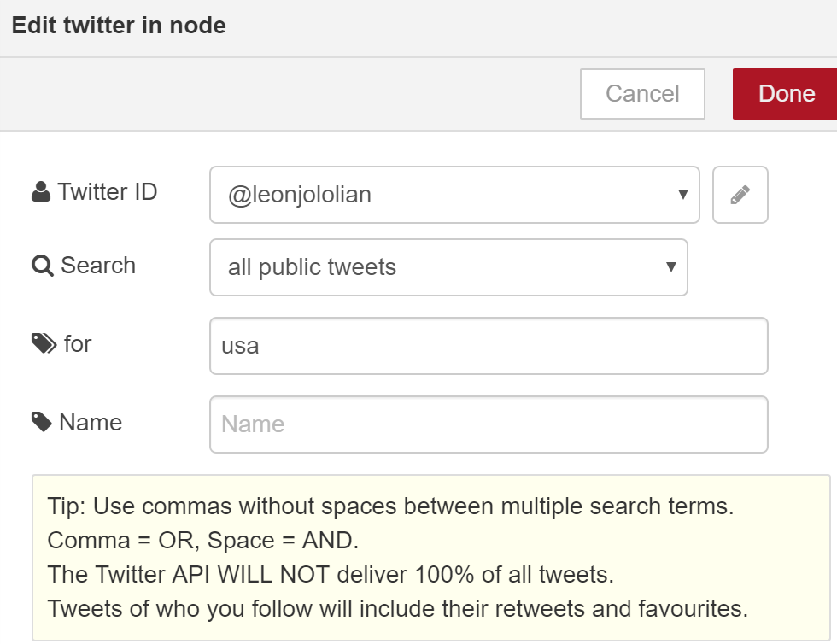
Create the following new flow by using the recently defined sub-flow:

Slide 45
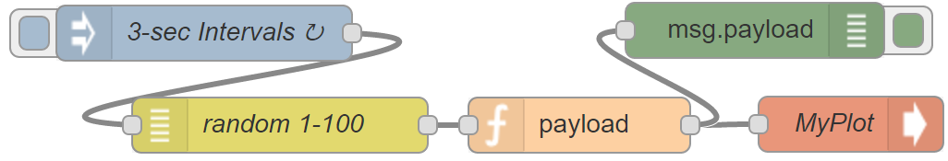
Visualization
Install in the Node-Red root directory using:
npm install node-red-contrib-freeboard –g
Function “payload”: w = { payload: {x : msg.payload} }; return w;
[{"id":"d940877b.277c48","type":"random","z":"7c1f2cae.387524","name":"random 1-100","low":"1","high":"100","inte":"true","x":321,"y":206,"wires":[["784f5de5.07a144"]]},{"id":"562efd48.e27c54","type":"inject","z":"7c1f2cae.387524","name":"3-sec Intervals","topic":"","payload":"","payloadType":"date","repeat":"3","crontab":"","once":false,"x":280,"y":156,"wires":[["d940877b.277c48"]]},{"id":"bc9e3685.563038","type":"freeboard","z":"7c1f2cae.387524","name":"MyPlot","x":630,"y":205.5,"wires":[]},{"id":"784f5de5.07a144","type":"function","z":"7c1f2cae.387524","name":"payload","func":"w = { payload: {x : msg.payload} }\nreturn w;","outputs":1,"noerr":0,"x":483,"y":206,"wires":[["bc9e3685.563038","76fcc880.fcaae8"]]},{"id":"76fcc880.fcaae8","type":"debug","z":"7c1f2cae.387524","name":"","active":true,"console":"false","complete":"payload","x":578,"y":154.5,"wires":[]}]

Slide 46
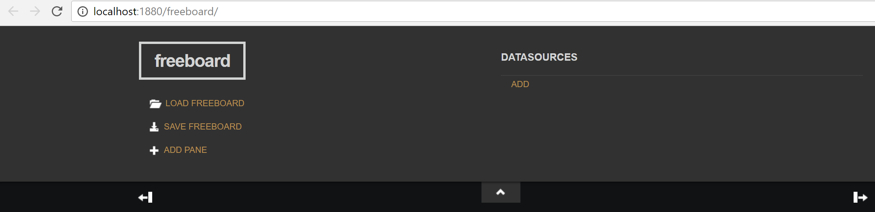
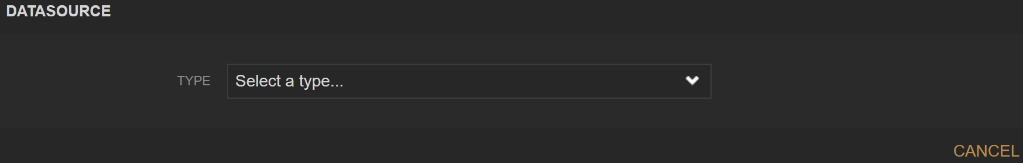
Go to: http://localhost:1880/freeboard/
Adding the freeboard node as Datasource: Click "ADD"
then choose the Type that has the Name of your Node-RED node

Slide 47
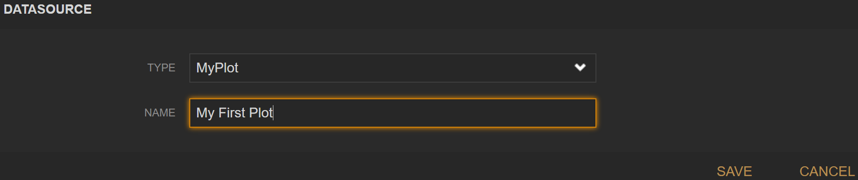
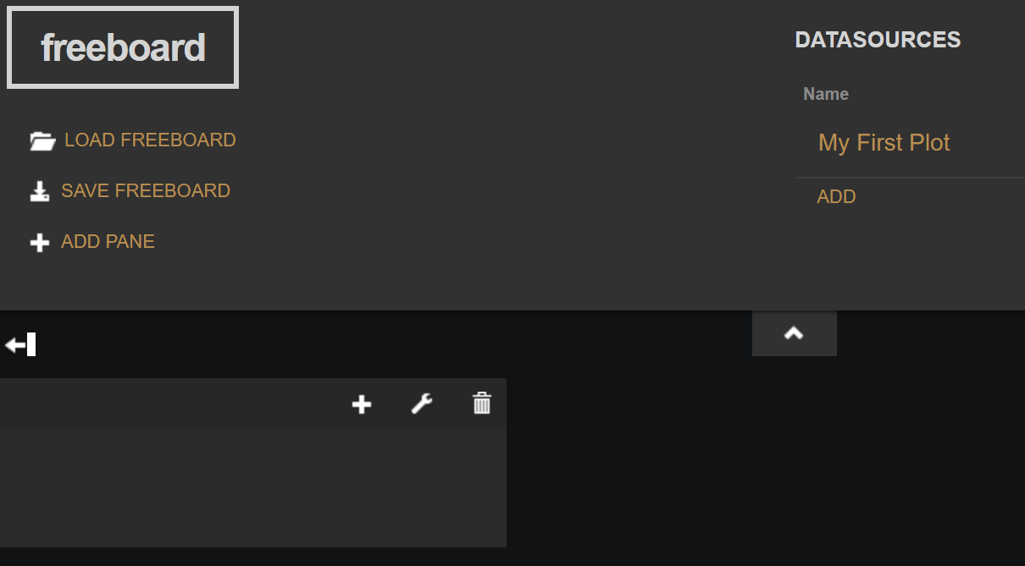
Defining the Datasource: Type a name and click SAVE
Adding a Widget: Click on "ADD PANE" on the top left and in the new created pane on the "+" sign in the title

Slide 48
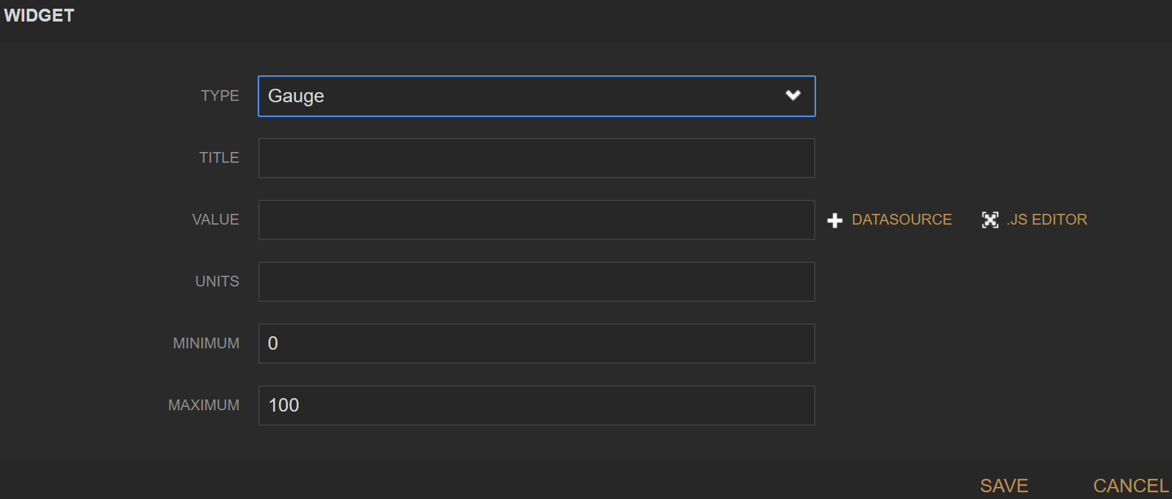
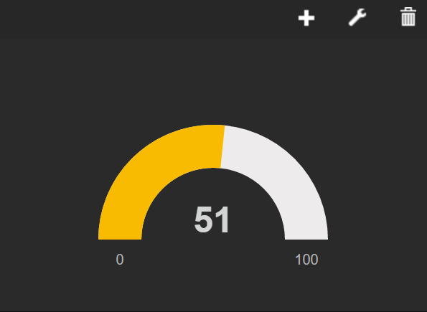
In the newly created pane, click on the "+" sign in the title and select “Gauge” from the drop down menu
Click on “+DATASOURCE” to choose the value to plot

Slide 49
Visualization using “Dashboard”
This module provides a set of nodes in Node-RED to quickly create a live data dashboard.
To install, run the following command in your Node-RED user directory (typically ~/.node-red):
npm i node-red-dashboard
When you run Node-RED, there will be UI nodes available in the palette and a new dashboard tab in the right side panel.
The UI interface is available at http://localhost:1880/ui

Slide 50
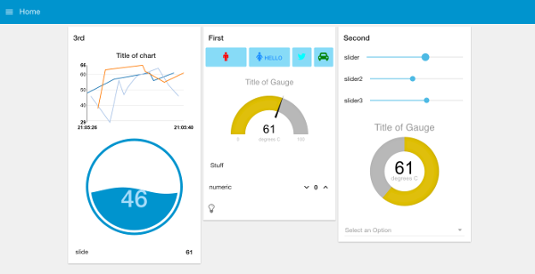
(https://flows.nodered.org/node/node-red-dashboard)

Slide 51
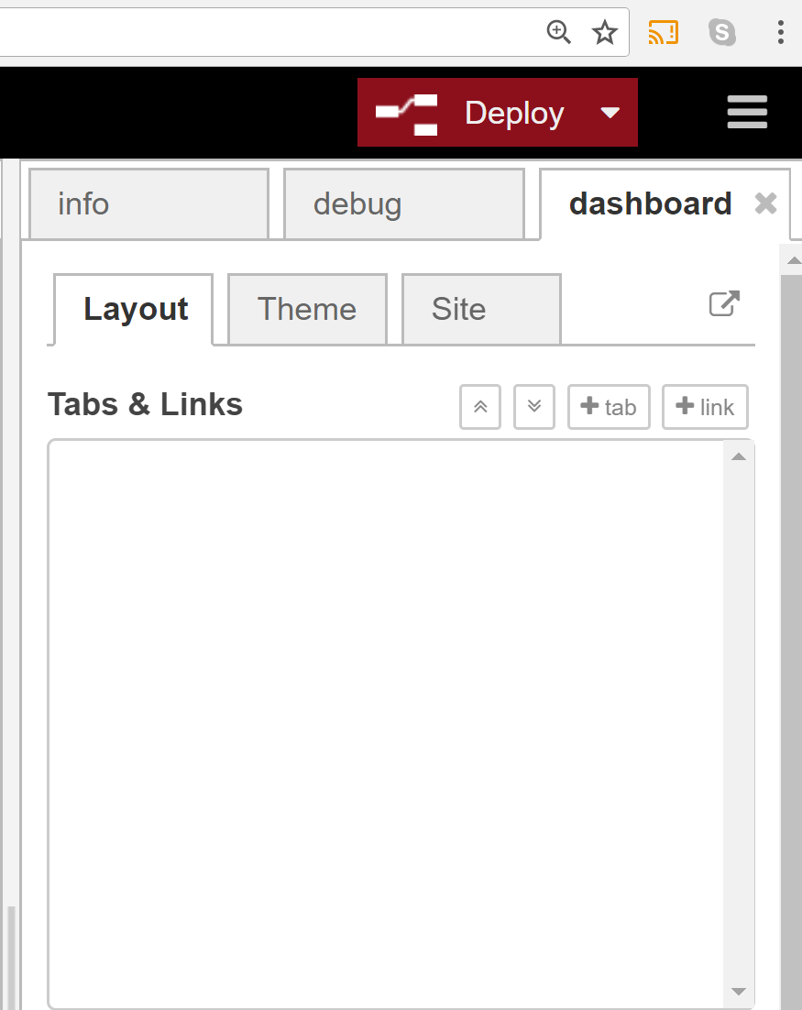
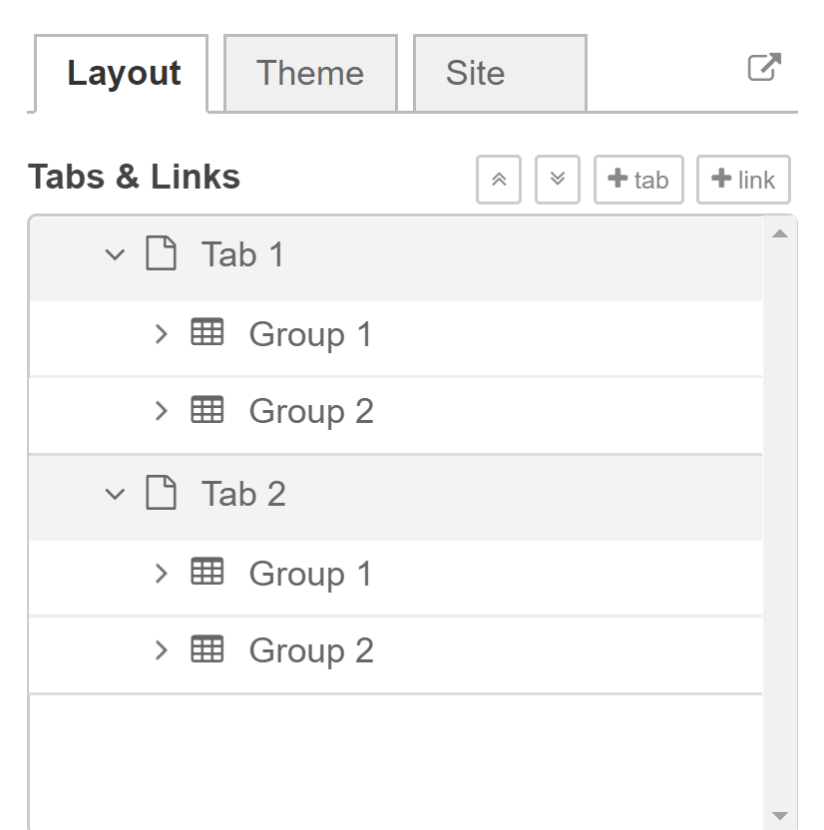
The Dashboard Tab
Click on the +tab button to create new tabs
Click on the +group button to create new groups

Slide 52
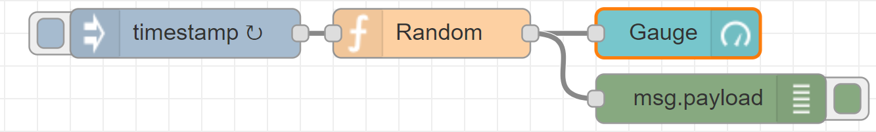
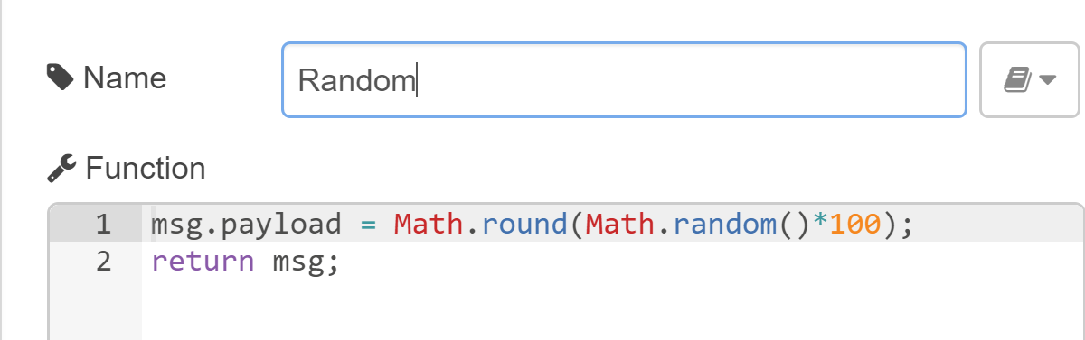
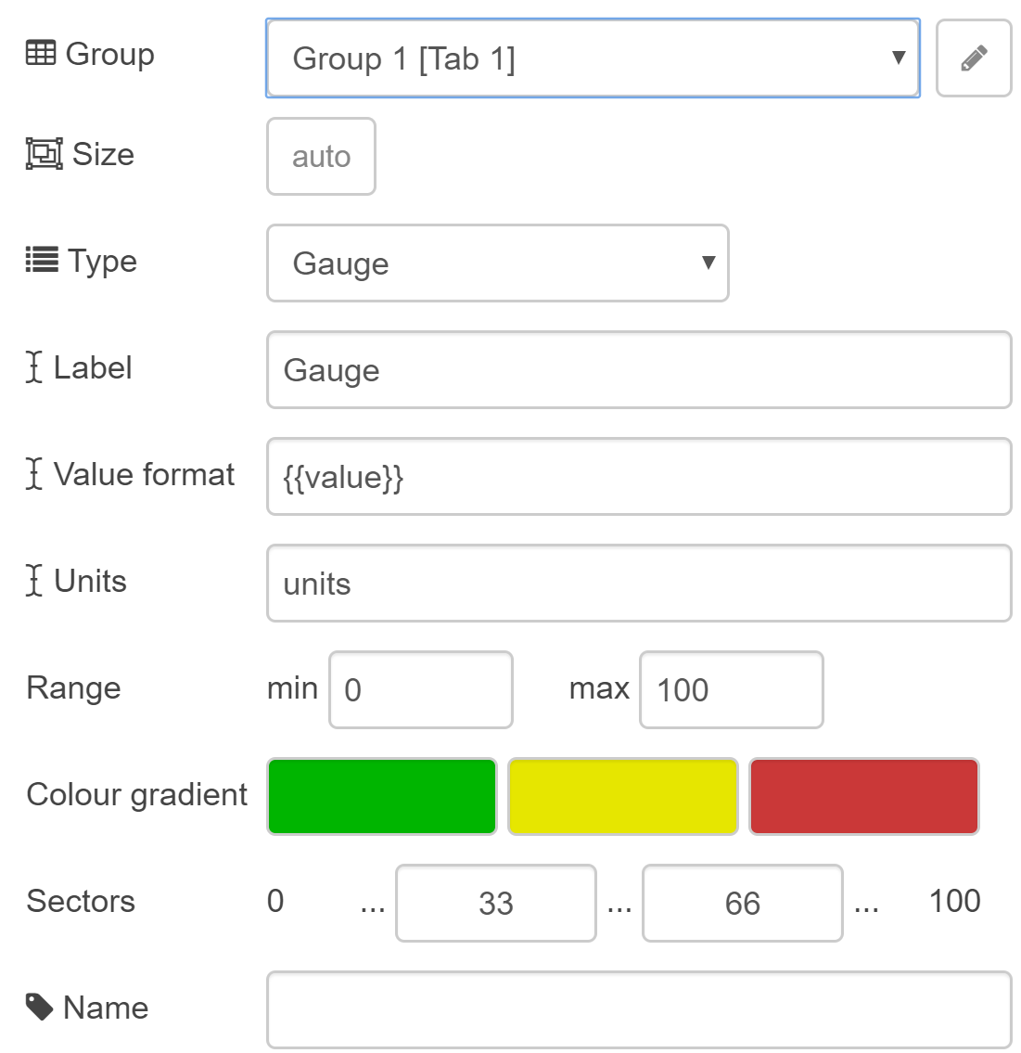
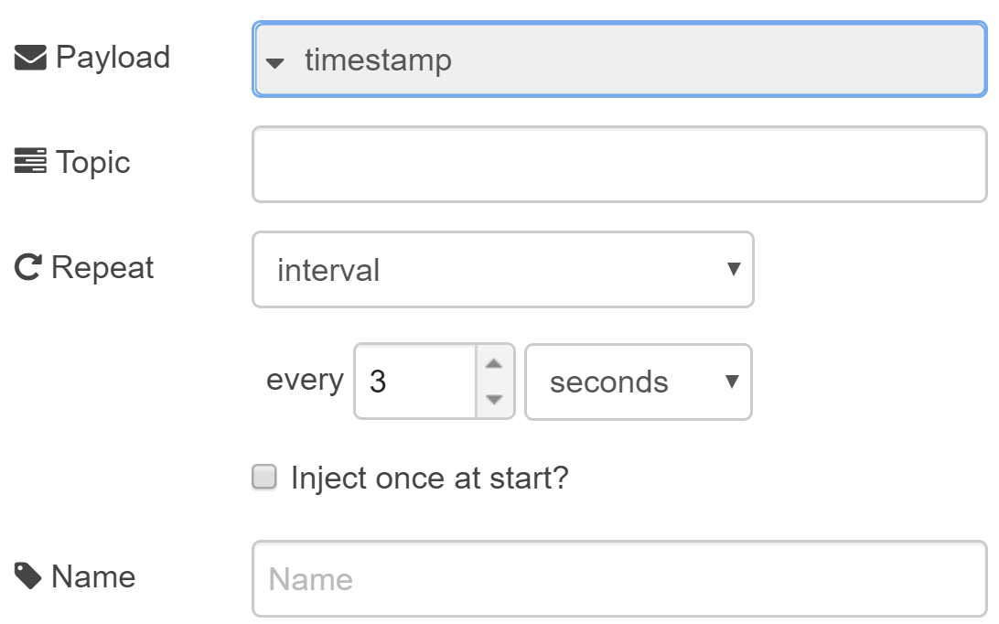

Slide 53

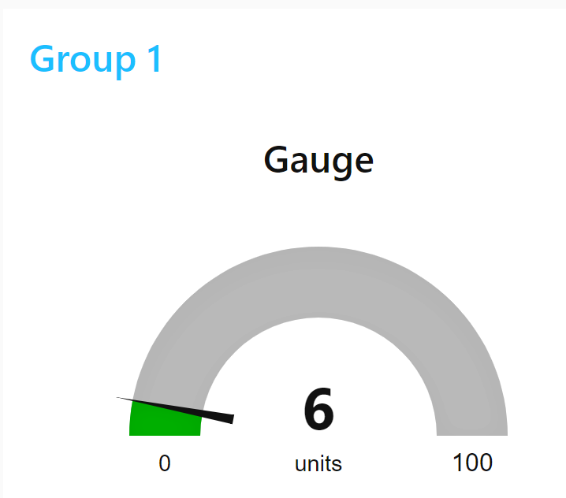
[{"id":"23f0ef11.c7ba2","type":"ui_gauge","z":"884eab00.fbd418","name":"","group":"45068169.712ab","order":0,"width":0,"height":0,"gtype":"gage","title":"Gauge","label":"units","format":"{{value}}","min":0,"max":"100","colors":["#00b500","#e6e600","#ca3838"],"seg1":"33","seg2":"66","x":430,"y":160,"wires":[]},{"id":"45068169.712ab","type":"ui_group","name":"Group 1","tab":"d78345f0.b44d78","order":1,"disp":true,"width":6},{"id":"d78345f0.b44d78","type":"ui_tab","name":"Tab 1","icon":"dashboard","order":1}]

Slide 54
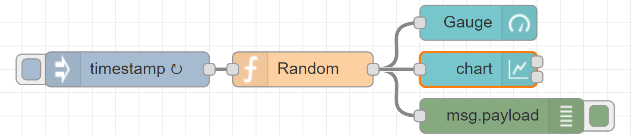
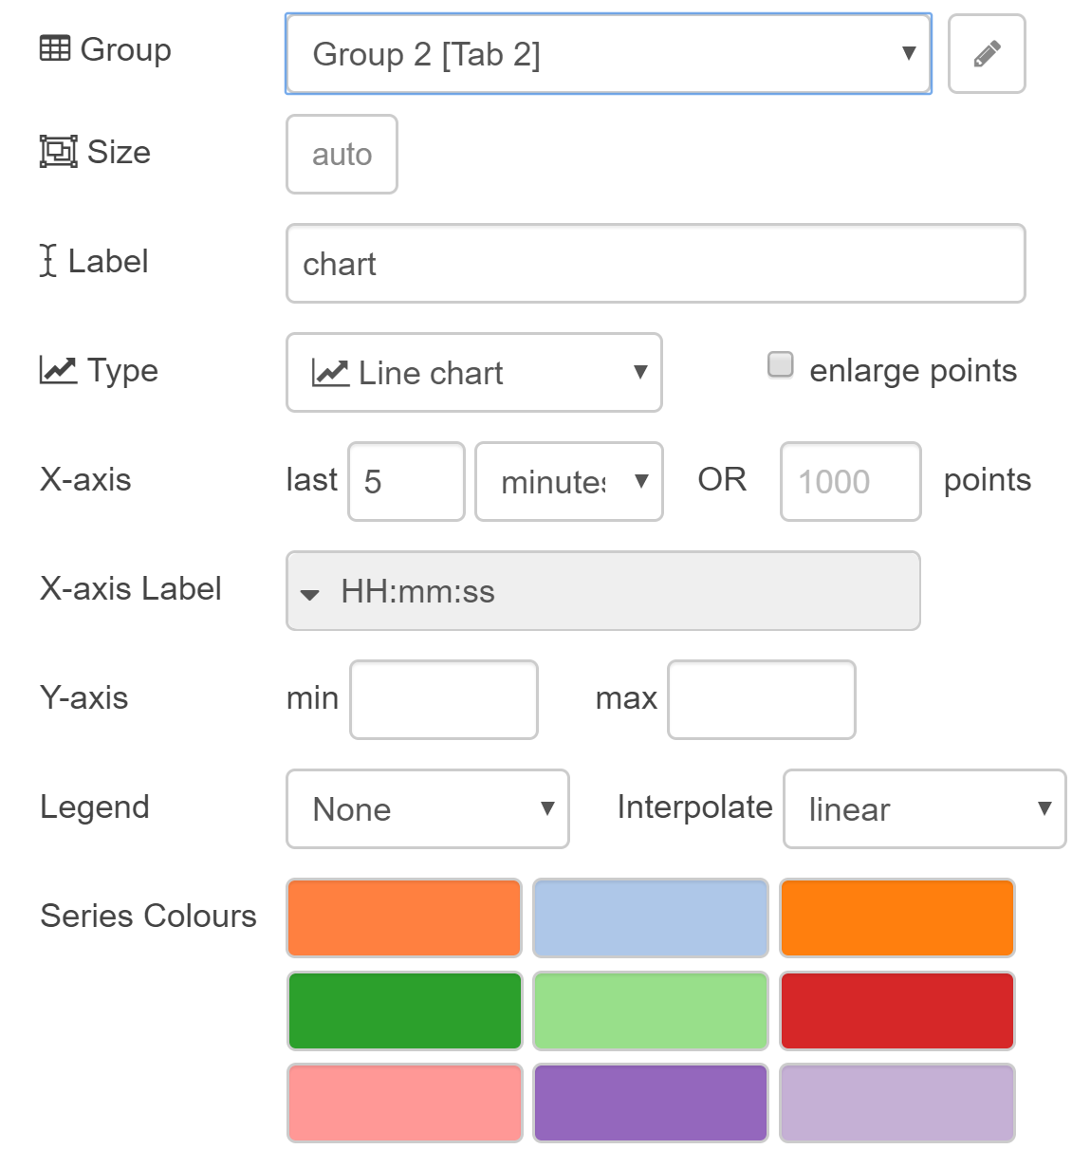
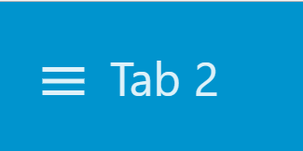
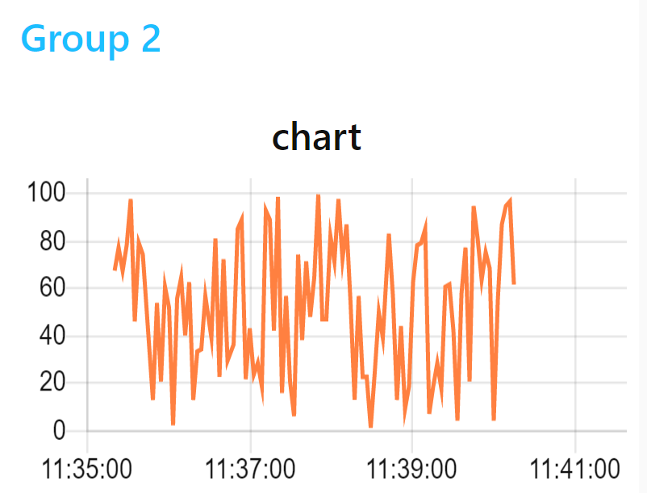
Adding a “Chart” to the UI

Slide 55
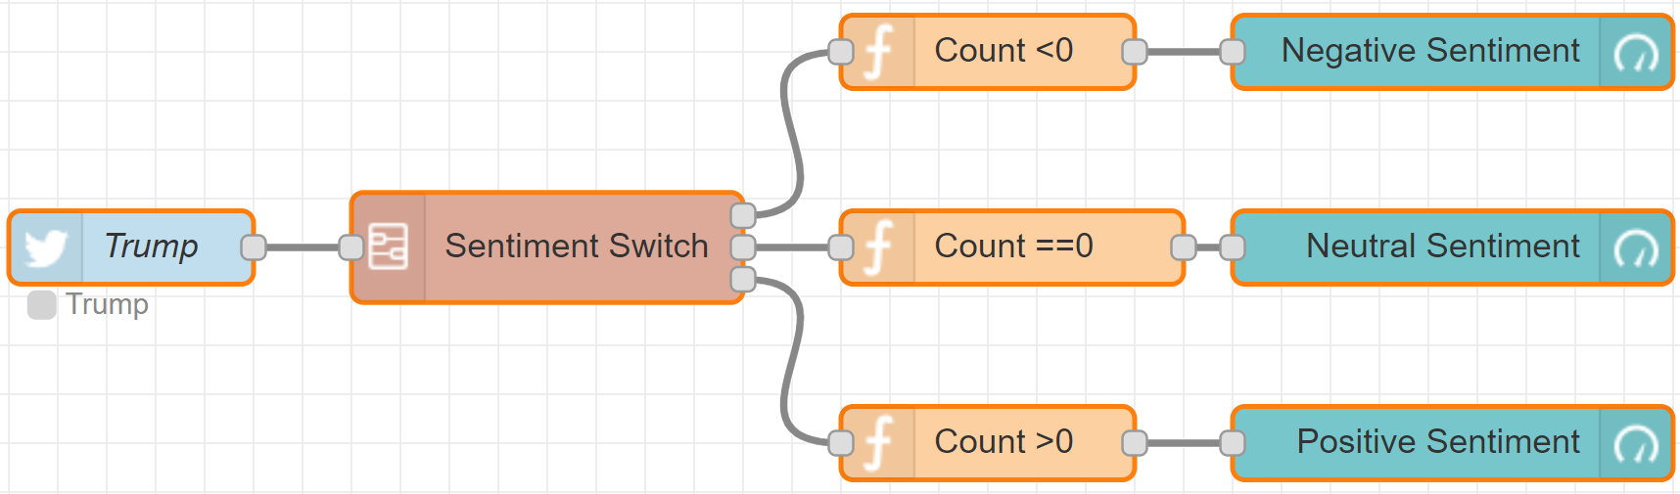
Monitoring the “Mood of the Country”

Slide 56
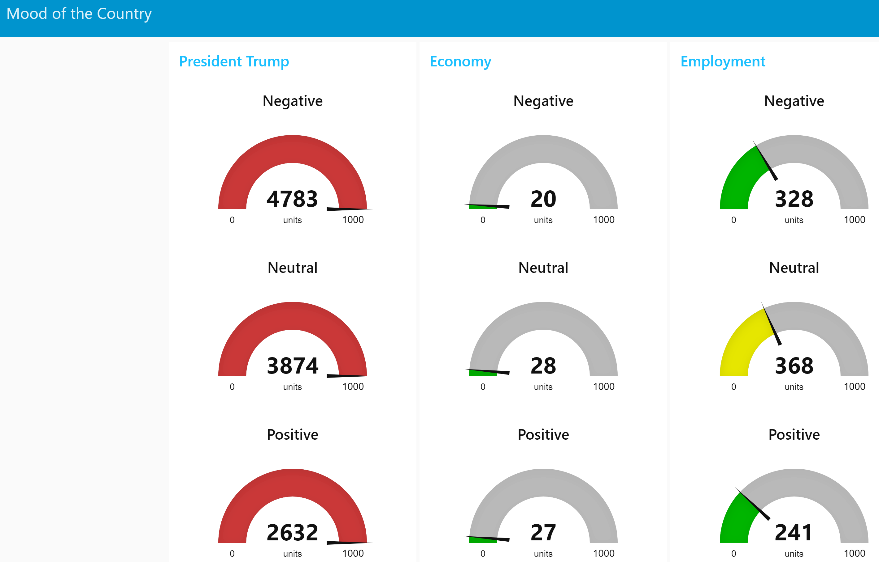

Slide 57

The Layout

Slide 58



Slide 59



Slide 60
Exporting the Code
[{"id":"80de10cb.65672","type":"subflow","name":"Sentiment Switch","info":"","in":[{"x":80,"y":100,"wires":[{"id":"92029e6b.f9726"}]}],"out":[{"x":720,"y":40,"wires":[{"id":"40badb90.faedf4","port":0}]},{"x":720,"y":100,"wires":[{"id":"40badb90.faedf4","port":1}]},{"x":720,"y":160,"wires":[{"id":"40badb90.faedf4","port":2}]}]},{"id":"92029e6b.f9726","type":"sentiment","z":"80de10cb.65672","name":"","x":220,"y":100,"wires":[["53c214c8.17fa3c"]]},{"id":"53c214c8.17fa3c","type":"function","z":"80de10cb.65672","name":"Process","func":"var newMsg = {\n payload : {\n tweet : msg.payload,\n score : msg.sentiment.score\n }\n};\nreturn newMsg;","outputs":1,"noerr":0,"x":380,"y":100,"wires":[["40badb90.faedf4"]]},{"id":"40badb90.faedf4","type":"switch","z":"80de10cb.65672","name":"","property":"payload.score","propertyType":"msg","rules":[{"t":"lt","v":"0","vt":"num"},{"t":"eq","v":"0","vt":"num"},{"t":"gt","v":"0","vt":"num"}],"checkall":"true","outputs":3,"x":530,"y":100,"wires":[[],[],[]]},{"id":"37a70b38.c650c4","type":"subflow:80de10cb.65672","z":"884eab00.fbd418","name":"","x":340,"y":160,"wires":[["e79c7acc.235838"],["9b047cf0.46c02"],["313d4713.669d38"]]},{"id":"c7efe75a.951628","type":"twitter in","z":"884eab00.fbd418","twitter":"","tags":"Trump","user":"false","name":"Trump","topic":"tweets","inputs":0,"x":170,"y":160,"wires":[["37a70b38.c650c4"]]},{"id":"e92f299e.47b0b8","type":"ui_gauge","z":"884eab00.fbd418","name":"Negative Sentiment","group":"45068169.712ab","order":0,"width":0,"height":0,"gtype":"gage","title":"Negative","label":"units","format":"{{value}}","min":"0","max":"1000","colors":["#00b500","#e6e600","#ca3838"],"seg1":"333","seg2":"666","x":710,"y":80,"wires":[]},{"id":"34fdc35.d461e3c","type":"ui_gauge","z":"884eab00.fbd418","name":"Neutral Sentiment","group":"45068169.712ab","order":0,"width":0,"height":0,"gtype":"gage","title":"Neutral","label":"units","format":"{{value}}","min":0,"max":"1000","colors":["#00b500","#e6e600","#ca3838"],"seg1":"333","seg2":"666","x":710,"y":160,"wires":[]},{"id":"30025dcc.098d02","type":"ui_gauge","z":"884eab00.fbd418","name":"Positive Sentiment","group":"45068169.712ab","order":0,"width":0,"height":0,"gtype":"gage","title":"Positive","label":"units","format":"{{value}}","min":0,"max":"1000","colors":["#00b500","#e6e600","#ca3838"],"seg1":"333","seg2":"666","x":710,"y":240,"wires":[]},{"id":"e79c7acc.235838","type":"function","z":"884eab00.fbd418","name":"Count <0","func":"var countNegative = context.get('countNegative')||0;\ncountNegative = countNegative + 1;\ncontext.set('countNegative',countNegative);\nmsg.payload = countNegative;\nreturn msg;","outputs":1,"noerr":0,"x":520,"y":80,"wires":[["e92f299e.47b0b8"]]},{"id":"9b047cf0.46c02","type":"function","z":"884eab00.fbd418","name":"Count ==0","func":"var countNeutral = context.get('countNeutral')||0;\ncountNeutral = countNeutral + 1;\ncontext.set('countNeutral',countNeutral);\nmsg.payload = countNeutral;\nreturn msg;","outputs":1,"noerr":0,"x":530,"y":160,"wires":[["34fdc35.d461e3c"]]},{"id":"313d4713.669d38","type":"function","z":"884eab00.fbd418","name":"Count >0","func":"var countPositive = context.get('countPositive')||0;\ncountPositive = countPositive + 1;\ncontext.set('countPositive',countPositive);\nmsg.payload = countPositive;\nreturn msg;","outputs":1,"noerr":0,"x":520,"y":240,"wires":[["30025dcc.098d02"]]},{"id":"45068169.712ab","type":"ui_group","z":"","name":"President Trump","tab":"d78345f0.b44d78","order":1,"disp":true,"width":"6"},{"id":"d78345f0.b44d78","type":"ui_tab","z":"","name":"Mood of the Country","icon":"dashboard","order":1}]

Slide 61

MQTT Node
To use the MQTT node, you need to have access to a broker.
Configure the MQTT node for the selected broker and a selected topic.
We assume that the published message will be in JSON format.
In order to parse the MQTT message Json message it receives, connect the subscriber to a JSON node.
Finally, connect the JSON node to a debug node.

Slide 62



MQTT Input Node Subscriber
Connects to a broker and subscribes to a specified topic.
It outputs a message with the properties:
msg.topic
msg.payload
msg.qos
msg.retain

Slide 63


JSON Node
A function that parses the msg.payload to convert a JSON string to/from a JavaScript object. Places the result back into the payload.
If the input is a JSON string it tries to parse it to a JavaScript object.
If the input is a JavaScript object it creates a JSON string.
Configuration tab:

Slide 64

Using an MQTT client, send the JSON message:
{"security" : "Red Alert"}
[{"id":"b22c091b.a3f8a8","type":"mqtt in","z":"7dec370e.907898","name":"Security Alert","topic":"security","qos":"1","broker":"142d3980.3a1c87","x":205,"y":237,"wires":[["82301b82.516ef8"]]},{"id":"82301b82.516ef8","type":"json","z":"7dec370e.907898","name":"","x":362,"y":236,"wires":[["826b2fd6.47e7c"]]},{"id":"826b2fd6.47e7c","type":"debug","z":"7dec370e.907898","name":"","active":true,"console":"false","complete":"true","x":507,"y":235.5,"wires":[]},{"id":"142d3980.3a1c87","type":"mqtt-broker","z":"7dec370e.907898","broker":"localhost","port":"1883","clientid":"","usetls":false,"compatmode":true,"keepalive":"60","cleansession":true,"willTopic":"","willQos":"0","willPayload":"","birthTopic":"","birthQos":"0","birthPayload":""}]

Slide 65

MQTT Output Node (Publisher)
This node allows us to configure an MQTT service and the topic to publish so that we can then send messages.
The following example consists of two flows:
Flow 1: consists of sensors that monitor the garage door and the front door. The sensors publish their status under the topic “security/garage” and “security/home” using an MQTT Output node
Flow 2: consists of a control center that receives MQTT published messages under the topic “security/+”. Depending on the contents of the MQTT message, it takes a corresponding action.

Slide 66




Sensors:

Slide 67



Control Center:

Slide 68
Sensors
[{"id":"21c4cb5e.c8fd14","type":"mqtt out","z":"f2cc463f.7cef28","name":"","topic":"","qos":"","retain":"","broker":"a31c36e0.0774f8","x":354,"y":193,"wires":[]},{"id":"2821f1b9.08708e","type":"inject","z":"f2cc463f.7cef28","name":"Garage","topic":"security/garage","payload":"{\"area\":\"garage\", \"door\":\"open\"}","payloadType":"str","repeat":"","crontab":"","once":false,"x":152.00001525878906,"y":164,"wires":[["21c4cb5e.c8fd14"]]},{"id":"b0042f92.048bd","type":"inject","z":"f2cc463f.7cef28","name":"Front Door","topic":"security/home","payload":"{\"area\" : \"front door\", \"status\" : \"unlocked\"}","payloadType":"str","repeat":"","crontab":"","once":false,"x":161.00001525878906,"y":238,"wires":[["21c4cb5e.c8fd14"]]},{"id":"a31c36e0.0774f8","type":"mqtt-broker","z":"f2cc463f.7cef28","broker":"127.0.0.1","port":"1883","clientid":"","usetls":false,"compatmode":true,"keepalive":"60","cleansession":true,"willTopic":"","willQos":"0","willPayload":"","birthTopic":"","birthQos":"0","birthPayload":""}]
Control Center
[{"id":"eea3d391.ad572","type":"mqtt in","z":"73b85683.bbba48","name":"","topic":"security/+","qos":"2","broker":"97db1efe.5325","x":131,"y":122.5,"wires":[["28ee1909.fe2e76"]]},{"id":"dc14deeb.3931f","type":"debug","z":"73b85683.bbba48","name":"","active":true,"console":"false","complete":"payload","x":453,"y":185,"wires":[]},{"id":"90e36738.348388","type":"function","z":"73b85683.bbba48","name":"Process Alert","func":"if (msg.payload.area==\"garage\")\n msg.payload.action = \"close garage door\";\nelse if(msg.payload.area==\"front door\")\n msg.payload.action = \"lock front door\"\nreturn msg;","outputs":1,"noerr":0,"x":271,"y":185,"wires":[["dc14deeb.3931f"]]},{"id":"28ee1909.fe2e76","type":"json","z":"73b85683.bbba48","name":"","x":295,"y":123,"wires":[["90e36738.348388"]]},{"id":"97db1efe.5325","type":"mqtt-broker","z":"73b85683.bbba48","broker":"127.0.0.1","port":"1883","clientid":"","usetls":false,"compatmode":true,"keepalive":"60","cleansession":true,"willTopic":"","willQos":"0","willPayload":"","birthTopic":"","birthQos":"0","birthPayload":""}]

Slide 69



Using a UI switch to control flow

Slide 70


Displaying Status in UI

Slide 71



Using Text-to-Speech

Slide 72
[{"id":"9f278519.197868","type":"mqtt out","z":"884eab00.fbd418","name":"","topic":"","qos":"","retain":"","broker":"3d440c20.e28004","x":510,"y":80,"wires":[]},{"id":"5f74fc71.724b64","type":"inject","z":"884eab00.fbd418","name":"Garage","topic":"security/garage","payload":"{\"area\":\"garage\", \"door\":\"open\"}","payloadType":"str","repeat":"","crontab":"","once":false,"x":108.00001525878906,"y":51,"wires":[["cbfcb9e8.bed948"]]},{"id":"189ceabd.39bc95","type":"inject","z":"884eab00.fbd418","name":"Front Door","topic":"security/home","payload":"{\"area\" : \"front door\", \"status\" : \"unlocked\"}","payloadType":"str","repeat":"","crontab":"","once":false,"x":117.00001525878906,"y":125,"wires":[["cbfcb9e8.bed948"]]},{"id":"76af9f35.5eecb","type":"mqtt in","z":"884eab00.fbd418","name":"","topic":"security/+","qos":"2","broker":"f29c7bf7.63d588","x":140,"y":280,"wires":[["d69cb2b8.d80c9"]]},{"id":"6bbc3fd0.4cd51","type":"debug","z":"884eab00.fbd418","name":"","active":true,"console":"false","complete":"payload","x":462,"y":342.5,"wires":[]},{"id":"e4403395.66daf","type":"function","z":"884eab00.fbd418","name":"Process Alert","func":"if (msg.payload.area==\"garage\")\n msg.payload.action = \"close garage door\";\nelse if(msg.payload.area==\"front door\")\n msg.payload.action = \"lock front door\"\nreturn msg;","outputs":1,"noerr":0,"x":280,"y":342.5,"wires":[["6bbc3fd0.4cd51","c54c243b.1dde28"]]},{"id":"d69cb2b8.d80c9","type":"json","z":"884eab00.fbd418","name":"","x":304,"y":280.5,"wires":[["e4403395.66daf"]]},{"id":"cbfcb9e8.bed948","type":"function","z":"884eab00.fbd418","name":"Control Switch","func":"var circuit = context.get(\"circuit\")||\"open\";\nif(msg.payload.circuit == \"open\"){\n context.set(\"circuit\", \"open\");\n return null;\n} else if(msg.payload.circuit == \"closed\"){\n context.set(\"circuit\", \"closed\");\n return null;\n}\nvar c = context.get(\"circuit\");\nif(c == \"closed\") return msg;","outputs":1,"noerr":0,"x":320,"y":80,"wires":[["9f278519.197868"]]},{"id":"717a9b06.32f1c4","type":"ui_switch","z":"884eab00.fbd418","name":"switch","label":"switch","group":"8212f405.597be8","order":0,"width":0,"height":0,"passthru":true,"decouple":"false","topic":"","style":"","onvalue":"{\"circuit\":\"closed\"}","onvalueType":"json","onicon":"","oncolor":"","offvalue":"{\"circuit\":\"open\"}","offvalueType":"json","officon":"","offcolor":"","x":180,"y":180,"wires":[["cbfcb9e8.bed948"]]},{"id":"8421caca.5554a8","type":"ui_audio","z":"884eab00.fbd418","name":"","group":"8212f405.597be8","voice":"4","always":true,"x":500,"y":400,"wires":[]},{"id":"c54c243b.1dde28","type":"function","z":"884eab00.fbd418","name":"Prepare Speech","func":"msg.payload = \"Alert\";\nreturn msg;","outputs":1,"noerr":0,"x":320,"y":400,"wires":[["8421caca.5554a8"]]},{"id":"3d440c20.e28004","type":"mqtt-broker","z":"884eab00.fbd418","broker":"127.0.0.1","port":"1883","clientid":"","usetls":false,"compatmode":true,"keepalive":"60","cleansession":true,"willTopic":"","willQos":"0","willPayload":"","birthTopic":"","birthQos":"0","birthPayload":""},{"id":"f29c7bf7.63d588","type":"mqtt-broker","z":"884eab00.fbd418","broker":"127.0.0.1","port":"1883","clientid":"","usetls":false,"compatmode":true,"keepalive":"60","cleansession":true,"willTopic":"","willQos":"0","willPayload":"","birthTopic":"","birthQos":"0","birthPayload":""},{"id":"8212f405.597be8","type":"ui_group","name":"Group 1","tab":"3ecc6ab0.77f806","order":1,"disp":true,"width":6},{"id":"3ecc6ab0.77f806","type":"ui_tab","z":"","name":"Security","icon":"dashboard","order":2}]

Slide 73


Showing Notifications

Slide 74




Using Dropdown Menus

Slide 75
[{"id":"2f54db8d.603244","type":"mqtt out","z":"884eab00.fbd418","name":"","topic":"","qos":"","retain":"","broker":"36215945.f9c686","x":270,"y":120,"wires":[]},{"id":"6bb7dacb.228984","type":"inject","z":"884eab00.fbd418","name":"Garage","topic":"security/garage","payload":"{\"area\":\"garage\", \"door\":\"open\"}","payloadType":"str","repeat":"","crontab":"","once":false,"x":90,"y":100,"wires":[["2f54db8d.603244"]]},{"id":"15a04013.f24d8","type":"inject","z":"884eab00.fbd418","name":"Front Door","topic":"security/home","payload":"{\"area\" : \"front door\", \"status\" : \"unlocked\"}","payloadType":"str","repeat":"","crontab":"","once":false,"x":100,"y":140,"wires":[["2f54db8d.603244"]]},{"id":"219c74e3.fc74ac","type":"mqtt in","z":"884eab00.fbd418","name":"","topic":"security/+","qos":"2","broker":"23d214f1.58ad6c","x":80,"y":200,"wires":[["b12b2403.37b678"]]},{"id":"ea96c452.7ac028","type":"function","z":"884eab00.fbd418","name":"Process Alert","func":"var c = context.get('device')||null;\nif(msg.payload == 'Front' || msg.payload == 'Garage'){ \n context.set('device', msg.payload);\n return;\n} else if (msg.payload.area=='garage' && c == 'Garage') {\n msg.payload.action = \"Close garage door\";\n return msg;\n} else if(msg.payload.area=='front door' && c == 'Front'){\n msg.payload.action = \"Lock front door!\";\n return msg;\n}","outputs":1,"noerr":0,"x":250,"y":260,"wires":[["d4339b37.b13938"]]},{"id":"b12b2403.37b678","type":"json","z":"884eab00.fbd418","name":"","pretty":false,"x":230,"y":200,"wires":[["ea96c452.7ac028"]]},{"id":"d4339b37.b13938","type":"ui_text","z":"884eab00.fbd418","group":"5abcc8e5.f2f9d8","order":0,"width":0,"height":0,"name":"","label":"text","format":"{{msg.payload.action}}","layout":"row-spread","x":410,"y":260,"wires":[]},{"id":"46688af8.24bc54","type":"ui_dropdown","z":"884eab00.fbd418","name":"","label":"Device","place":"Select option","group":"5abcc8e5.f2f9d8","order":0,"width":0,"height":0,"passthru":true,"options":[{"label":"","value":"Garage","type":"str"},{"label":"","value":"Front","type":"str"}],"payload":"","topic":"","x":70,"y":260,"wires":[["ea96c452.7ac028"]]},{"id":"36215945.f9c686","type":"mqtt-broker","z":"884eab00.fbd418","broker":"127.0.0.1","port":"1883","clientid":"","usetls":false,"compatmode":true,"keepalive":"60","cleansession":true,"willTopic":"","willQos":"0","willPayload":"","birthTopic":"","birthQos":"0","birthPayload":""},{"id":"23d214f1.58ad6c","type":"mqtt-broker","z":"884eab00.fbd418","broker":"127.0.0.1","port":"1883","clientid":"","usetls":false,"compatmode":true,"keepalive":"60","cleansession":true,"willTopic":"","willQos":"0","willPayload":"","birthTopic":"","birthQos":"0","birthPayload":""},{"id":"5abcc8e5.f2f9d8","type":"ui_group","name":"Group 1","tab":"8d19f35d.59df8","order":1,"disp":true,"width":6},{"id":"8d19f35d.59df8","type":"ui_tab","name":"Tab 2","icon":"dashboard","order":2}]

Slide 76


Using “Switch Node” with a JSON object

Slide 77


Using “Change Node” to Change the payload

Slide 78



Using “rbe Node” (report by exception)

Slide 79


Using “range Node” to Scale the input

Slide 80


Using “mqtt output Node” to test the flow

Slide 81
Web Sockets
Web sockets provide a duplex TCP connection.
They are designed to allow two processes, such as a web browser and a Web server, to maintain a channel of communication in addition to the basic HTTP one.
The input Web socket node allows us to listen for incoming data.
The output Web socket allows us to send data. It is designed to check for a payload originated at a Web socket in a node, in which case it responds to the original sender. Otherwise it will broadcast the payload to all connected Web sockets.
Both input and output Web socket nodes can be configured as either server or client – in server mode they ‘listen on’ a URL, and in client mode they connect to a specified IP address.

Slide 82




[{"id":"559112dc.deefbc","type":"websocket out","z":"cb0068af.09a3a8","name":"","server":"1f12051d.37ccbb","client":"","x":382,"y":123.5,"wires":[]},{"id":"4c73d07.ea2343","type":"inject","z":"cb0068af.09a3a8","name":"","topic":"","payload":"Hello, World!","payloadType":"str","repeat":"","crontab":"","once":false,"x":151,"y":123,"wires":[["559112dc.deefbc"]]},{"id":"7a2550c3.ea97","type":"websocket in","z":"cb0068af.09a3a8","name":"","server":"1f12051d.37ccbb","client":"","x":233,"y":188,"wires":[["539ed205.8843dc"]]},{"id":"539ed205.8843dc","type":"debug","z":"cb0068af.09a3a8","name":"","active":true,"console":"false","complete":"false","x":461,"y":187.5,"wires":[]},{"id":"1f12051d.37ccbb","type":"websocket-listener","z":"cb0068af.09a3a8","path":"wss://echo.websocket.org","wholemsg":"false"}]

Slide 83

The Exec Node
[{"id":"57e52825.8acbd8","type":"exec","z":"1da6ea7e.8f4c16","command":"dir","addpay":false,"append":"c:\\","useSpawn":"","timer":"","name":"","x":316,"y":125.5,"wires":[["17cb78b1.7e5dc7"],[],[]]},{"id":"9f0be68c.d52668","type":"inject","z":"1da6ea7e.8f4c16","name":"","topic":"","payload":"","payloadType":"date","repeat":"","crontab":"","once":false,"x":143,"y":125,"wires":[["57e52825.8acbd8"]]},{"id":"17cb78b1.7e5dc7","type":"debug","z":"1da6ea7e.8f4c16","name":"","active":true,"console":"false","complete":"false","x":485,"y":124.5,"wires":[]}]
[{"id":"d7b1727b.f885","type":"debug","z":"a98e6067.4f419","name":"","active":true,"complete":false,"x":556,"y":249,"wires":[]},{"id":"764110c6.7b70e","type":"exec","z":"a98e6067.4f419","command":"netstat -an","addpay":false,"append":"| findstr LISTEN","useSpawn":false,"timer":"","name":"","x":386.99998474121094,"y":246.00001525878906,"wires":[["d7b1727b.f885"],[],[]]},{"id":"219070fb.d825a","type":"inject","z":"a98e6067.4f419","name":"","topic":"","payload":" ","repeat":"","crontab":"","once":false,"x":229.99998474121094,"y":246.00001525878906,"wires":[["764110c6.7b70e"]]}]

Slide 84

The File in Node
Reads the specified file and sends the content as msg.payload, and the filename as msg.filename.
[{"id":"55893185.0d1b6","type":"file in","z":"1da6ea7e.8f4c16","name":"read test.txt","filename":"c:\\tmp\\test.txt","format":"utf8","x":290,"y":135,"wires":[["130f181.2ceb7e8"]]},{"id":"12e01394.3444cc","type":"inject","z":"1da6ea7e.8f4c16","name":"","topic":"","payload":"","payloadType":"date","repeat":"","crontab":"","once":false,"x":117,"y":135,"wires":[["55893185.0d1b6"]]},{"id":"130f181.2ceb7e8","type":"debug","z":"1da6ea7e.8f4c16","name":"","active":true,"console":"false","complete":"false","x":468,"y":135.5,"wires":[]}]

Slide 85



The File out Node
[{"id":"cc357043.e9dd6","type":"file","z":"1da6ea7e.8f4c16","name":"Append to c:\\tmp\\test.txt","filename":"c:\\tmp\\test.txt","appendNewline":true,"createDir":false,"overwriteFile":"false","x":498,"y":101,"wires":[]},{"id":"5238baf3.e8d834","type":"inject","z":"1da6ea7e.8f4c16","name":"","topic":"","payload":"Goodbye!","payloadType":"str","repeat":"","crontab":"","once":false,"x":220,"y":101,"wires":[["cc357043.e9dd6"]]}]

Slide 86

[{"id":"2c4de20a.bcb7be","type":"function","z":"d9f204f5.da5328","name":"Temperature","func":"var t = Math.floor(Math.random()*30) + 60;\nmsg.payload = t;\nreturn msg;","outputs":1,"noerr":0,"x":281,"y":119,"wires":[["26bd2623.715bea","3a64f3b0.b8208c"]]},{"id":"637a498b.8eeb98","type":"inject","z":"d9f204f5.da5328","name":"","topic":"","payload":"","payloadType":"date","repeat":"2","crontab":"","once":false,"x":99,"y":120,"wires":[["2c4de20a.bcb7be"]]},{"id":"26bd2623.715bea","type":"debug","z":"d9f204f5.da5328","name":"","active":true,"console":"false","complete":"payload","x":472,"y":98.5,"wires":[]},{"id":"142a9aea.fce0c5","type":"function","z":"d9f204f5.da5328","name":"Humidity","func":"//var h;\nif(msg.payload == \"change\") {\n var h_switch = context.get('h_switch')||0;\n h_switch = 1 - h_switch;\n context.set('h_switch',h_switch);\n}\n\nif(context.get('h_switch'))\n h = Math.floor(Math.random()*40)+60;\nelse h = 0;\n\nmsg.payload = h;\nreturn msg;","outputs":1,"noerr":0,"x":269,"y":195,"wires":[["e982bdfb.ecc11","2add083f.563198"]]},{"id":"e982bdfb.ecc11","type":"debug","z":"d9f204f5.da5328","name":"","active":true,"console":"false","complete":"payload","x":472,"y":213.5,"wires":[]},{"id":"1418d77d.da6f69","type":"inject","z":"d9f204f5.da5328","name":"","topic":"","payload":"","payloadType":"date","repeat":"3","crontab":"","once":false,"x":98,"y":196,"wires":[["142a9aea.fce0c5"]]},{"id":"6133fdb0.63ab14","type":"ui_button","z":"d9f204f5.da5328","name":"push","group":"57dcf85e.df7218","order":0,"width":0,"height":0,"label":"button","color":"","bgcolor":"","icon":"","payload":"change","payloadType":"str","topic":"","x":94,"y":302.5,"wires":[["142a9aea.fce0c5"]]},{"id":"3a64f3b0.b8208c","type":"ui_chart","z":"d9f204f5.da5328","name":"chart 1","group":"57dcf85e.df7218","order":0,"width":0,"height":0,"label":"chart","chartType":"line","legend":"false","xformat":"HH:mm:ss","interpolate":"linear","nodata":"","ymin":"","ymax":"","removeOlder":1,"removeOlderPoints":"","removeOlderUnit":"3600","cutout":0,"colors":["#1f77b4","#aec7e8","#ff7f0e","#2ca02c","#98df8a","#d62728","#ff9896","#9467bd","#c5b0d5"],"x":473,"y":146.5,"wires":[[],[]]},{"id":"2add083f.563198","type":"ui_gauge","z":"d9f204f5.da5328","name":"","group":"57dcf85e.df7218","order":0,"width":0,"height":0,"gtype":"gage","title":"Gauge","label":"units","format":"{{value}}","min":"60","max":"100","colors":["#00b500","#e6e600","#ca3838"],"x":442,"y":267.5,"wires":[]},{"id":"57dcf85e.df7218","type":"ui_group","z":"d9f204f5.da5328","name":"Default","tab":"6aa66ef2.51118","disp":true,"width":"6"},{"id":"6aa66ef2.51118","type":"ui_tab","z":"d9f204f5.da5328","name":"Home","icon":"dashboard"}]

Slide 87


Adding a Time Stamp to the Payload
[{"id":"5f74fc71.724b64","type":"inject","z":"884eab00.fbd418","name":"Garage","topic":"security/garage","payload":"{\"area\":\"garage\", \"door\":\"open\", \"test\": false}","payloadType":"json","repeat":"","crontab":"","once":false,"x":368.00001525878906,"y":51,"wires":[["cbfcb9e8.bed948"]]},{"id":"189ceabd.39bc95","type":"inject","z":"884eab00.fbd418","name":"Front Door","topic":"security/home","payload":"{\"area\" : \"front door\", \"status\" : \"unlocked\", \"test\": false}","payloadType":"str","repeat":"","crontab":"","once":false,"x":380,"y":100,"wires":[["cbfcb9e8.bed948"]]},{"id":"cbfcb9e8.bed948","type":"function","z":"884eab00.fbd418","name":"Control Switch","func":"var circuit = context.get(\"circuit\")||\"open\";\nif(msg.payload.circuit == \"open\"){\n context.set(\"circuit\", \"open\");\n return null;\n} else if(msg.payload.circuit == \"closed\"){\n context.set(\"circuit\", \"closed\");\n return null;\n}\nvar c = context.get(\"circuit\");\nif(c == \"closed\") {\n msg.payload.timestamp = new Date();\n return msg;\n}","outputs":1,"noerr":0,"x":600,"y":60,"wires":[["9f278519.197868","c562edd8.47ca6"]]},{"id":"717a9b06.32f1c4","type":"ui_switch","z":"884eab00.fbd418","name":"Deactivate All Sensors","label":"Deactivate All Sensors","group":"8212f405.597be8","order":0,"width":0,"height":0,"passthru":true,"decouple":"false","topic":"","style":"","onvalue":"{\"circuit\":\"closed\"}","onvalueType":"json","onicon":"","oncolor":"","offvalue":"{\"circuit\":\"open\"}","offvalueType":"json","officon":"","offcolor":"","x":440,"y":140,"wires":[["cbfcb9e8.bed948"]]},{"id":"8212f405.597be8","type":"ui_group","name":"Group 1","tab":"3ecc6ab0.77f806","order":1,"disp":true,"width":6},{"id":"3ecc6ab0.77f806","type":"ui_tab","z":"","name":"Security","icon":"dashboard","order":2}]

Slide 88


Configuring Through the Web
[{"id":"717a9b06.32f1c4","type":"ui_switch","z":"884eab00.fbd418","name":"Deactivate All Sensors","label":"Deactivate All Sensors","group":"8212f405.597be8","order":0,"width":0,"height":0,"passthru":true,"decouple":"false","topic":"","style":"","onvalue":"{\"circuit\":\"closed\"}","onvalueType":"json","onicon":"","oncolor":"","offvalue":"{\"circuit\":\"open\"}","offvalueType":"json","officon":"","offcolor":"","x":440,"y":260,"wires":[["cbfcb9e8.bed948"]]},{"id":"989f28bc.c35eb8","type":"http in","z":"884eab00.fbd418","name":"off","url":"/off","method":"get","upload":false,"swaggerDoc":"","x":70,"y":260,"wires":[["7d769d16.eab8b4"]]},{"id":"7d769d16.eab8b4","type":"function","z":"884eab00.fbd418","name":"","func":"var replyMsg = {\"payload\" : msg.payload};\nmsg.payload = \"Dectivated\";\nreturn [replyMsg, msg];\n","outputs":"2","noerr":0,"x":210,"y":260,"wires":[["717a9b06.32f1c4"],["c8bbb6dc.6c2e98"]]},{"id":"c3551556.bcabc8","type":"http in","z":"884eab00.fbd418","name":"on","url":"/on","method":"get","upload":false,"swaggerDoc":"","x":70,"y":300,"wires":[["cd811786.e1acc8"]]},{"id":"cd811786.e1acc8","type":"function","z":"884eab00.fbd418","name":"","func":"replyMsg = {payload : msg.payload};\nmsg.payload = \"Activated\";\nreturn [replyMsg, msg];","outputs":"2","noerr":0,"x":210,"y":300,"wires":[["717a9b06.32f1c4"],["c8bbb6dc.6c2e98"]]},{"id":"c8bbb6dc.6c2e98","type":"http response","z":"884eab00.fbd418","name":"","statusCode":"","headers":{},"x":390,"y":300,"wires":[]},{"id":"8212f405.597be8","type":"ui_group","name":"Group 1","tab":"3ecc6ab0.77f806","order":1,"disp":true,"width":6},{"id":"3ecc6ab0.77f806","type":"ui_tab","z":"","name":"Security","icon":"dashboard","order":2}]

Slide 89





Slide 90


Using text Input
[{"id":"701890.1745177","type":"ui_text","z":"884eab00.fbd418","group":"8212f405.597be8","order":0,"width":0,"height":0,"name":"","label":"Message","format":"{{msg.payload}}","layout":"col-center","x":680,"y":634,"wires":[]},{"id":"b2a0a7ba.ef8988","type":"function","z":"884eab00.fbd418","name":"Prepare output Text","func":"var userName = context.get(\"username\")||\"anonymous\";\nif (msg.topic == \"User Name\") {\n context.set(\"username\", msg.payload);\n} else {\n var name = context.get(\"username\") + \", \";\n msg.payload = name + msg.payload.action;\n return msg;\n}","outputs":1,"noerr":0,"x":490,"y":654,"wires":[["701890.1745177","f7c781fe.9e12","727ce0ca.f7fb1"]]},{"id":"f7c781fe.9e12","type":"ui_toast","z":"884eab00.fbd418","position":"top right","displayTime":"3","highlight":"","outputs":0,"ok":"OK","cancel":"","topic":"","name":"","x":710,"y":674,"wires":[]},{"id":"65f87aa3.e81c74","type":"ui_text_input","z":"884eab00.fbd418","name":"User Name","label":"Enter your name","group":"8212f405.597be8","order":0,"width":0,"height":0,"passthru":true,"mode":"text","delay":"0","topic":"User Name","x":230,"y":654,"wires":[["b2a0a7ba.ef8988"]]},{"id":"8212f405.597be8","type":"ui_group","name":"Group 1","tab":"3ecc6ab0.77f806","order":1,"disp":true,"width":6},{"id":"3ecc6ab0.77f806","type":"ui_tab","z":"","name":"Security","icon":"dashboard","order":2}]

Slide 91
[{"id":"9f278519.197868","type":"mqtt out","z":"884eab00.fbd418","name":"","topic":"","qos":"","retain":"","broker":"3d440c20.e28004","x":810,"y":60,"wires":[]},{"id":"5f74fc71.724b64","type":"inject","z":"884eab00.fbd418","name":"Garage","topic":"security/garage","payload":"{\"area\":\"garage\", \"door\":\"open\", \"test\": false}","payloadType":"json","repeat":"","crontab":"","once":false,"x":368.00001525878906,"y":51,"wires":[["cbfcb9e8.bed948"]]},{"id":"189ceabd.39bc95","type":"inject","z":"884eab00.fbd418","name":"Front Door","topic":"security/home","payload":"{\"area\" : \"front door\", \"status\" : \"unlocked\", \"test\": false}","payloadType":"str","repeat":"","crontab":"","once":false,"x":380,"y":100,"wires":[["cbfcb9e8.bed948"]]},{"id":"76af9f35.5eecb","type":"mqtt in","z":"884eab00.fbd418","name":"","topic":"security/+","qos":"2","broker":"f29c7bf7.63d588","x":80,"y":382,"wires":[["d69cb2b8.d80c9"]]},{"id":"6bbc3fd0.4cd51","type":"debug","z":"884eab00.fbd418","name":"","active":true,"console":"false","complete":"payload","x":570,"y":516,"wires":[]},{"id":"e4403395.66daf","type":"function","z":"884eab00.fbd418","name":"Process Alert","func":"if (msg.payload.area==\"garage\")\n msg.payload.action = \"close garage door\";\nelse if(msg.payload.area==\"front door\")\n msg.payload.action = \"lock front door\"\nreturn msg;","outputs":1,"noerr":0,"x":350,"y":382,"wires":[["6bbc3fd0.4cd51","c54c243b.1dde28","b2a0a7ba.ef8988","86350e52.2d771"]]},{"id":"d69cb2b8.d80c9","type":"json","z":"884eab00.fbd418","name":"","x":210,"y":382,"wires":[["e4403395.66daf"]]},{"id":"cbfcb9e8.bed948","type":"function","z":"884eab00.fbd418","name":"Control Switch","func":"var circuit = context.get(\"circuit\")||\"open\";\nif(msg.payload.circuit == \"open\"){\n context.set(\"circuit\", \"open\");\n return null;\n} else if(msg.payload.circuit == \"closed\"){\n context.set(\"circuit\", \"closed\");\n return null;\n}\nvar c = context.get(\"circuit\");\nif(c == \"closed\") {\n msg.payload.timestamp = new Date();\n return msg;\n}","outputs":1,"noerr":0,"x":600,"y":60,"wires":[["9f278519.197868","c562edd8.47ca6"]]},{"id":"717a9b06.32f1c4","type":"ui_switch","z":"884eab00.fbd418","name":"Deactivate All Sensors","label":"Deactivate All Sensors","group":"8212f405.597be8","order":0,"width":0,"height":0,"passthru":true,"decouple":"false","topic":"","style":"","onvalue":"{\"circuit\":\"closed\"}","onvalueType":"json","onicon":"","oncolor":"","offvalue":"{\"circuit\":\"open\"}","offvalueType":"json","officon":"","offcolor":"","x":440,"y":260,"wires":[["cbfcb9e8.bed948"]]},{"id":"8421caca.5554a8","type":"ui_audio","z":"884eab00.fbd418","name":"","group":"8212f405.597be8","voice":"4","always":true,"x":803,"y":576,"wires":[]},{"id":"c54c243b.1dde28","type":"function","z":"884eab00.fbd418","name":"Prepare output Speech","func":"if(msg.payload.test == true){\n msg.payload = \"testing garage sensor\"\n return msg;\n} else {\n msg.payload = \"Alert\";\n return msg;\n}","outputs":1,"noerr":0,"x":593,"y":576,"wires":[["8421caca.5554a8"]]},{"id":"701890.1745177","type":"ui_text","z":"884eab00.fbd418","group":"8212f405.597be8","order":0,"width":0,"height":0,"name":"","label":"Message","format":"{{msg.payload}}","layout":"col-center","x":680,"y":634,"wires":[]},{"id":"b2a0a7ba.ef8988","type":"function","z":"884eab00.fbd418","name":"Prepare output Text","func":"var userName = context.get(\"username\")||\"anonymous\";\nif (msg.topic == \"User Name\") {\n context.set(\"username\", msg.payload);\n} else {\n var name = context.get(\"username\") + \", \";\n msg.payload = name + msg.payload.action;\n return msg;\n}","outputs":1,"noerr":0,"x":490,"y":654,"wires":[["701890.1745177","f7c781fe.9e12","727ce0ca.f7fb1"]]},{"id":"17101481.cbc54b","type":"ui_chart","z":"884eab00.fbd418","name":"Event Log","group":"8212f405.597be8","order":0,"width":0,"height":0,"label":"chart","chartType":"line","legend":"false","xformat":"mm:ss","interpolate":"linear","nodata":"","dot":false,"ymin":"0","ymax":"10","removeOlder":"30","removeOlderPoints":"","removeOlderUnit":"60","cutout":0,"colors":["#1f77b4","#aec7e8","#ff7f0e","#2ca02c","#98df8a","#d62728","#ff9896","#9467bd","#c5b0d5"],"useOldStyle":false,"x":780,"y":420,"wires":[[],[]]},{"id":"86350e52.2d771","type":"function","z":"884eab00.fbd418","name":"Log Event","func":"var count = context.get('count')||0;\ncount += 1;\ncontext.set('count', count);\n\nlogMsg = {payload : msg.payload};\nlogMsg.payload = msg.payload;\nmsg.payload = count;\nreturn [logMsg, msg];","outputs":"2","noerr":0,"x":600,"y":420,"wires":[["16357a92.a00915"],["17101481.cbc54b"]]},{"id":"f7c781fe.9e12","type":"ui_toast","z":"884eab00.fbd418","position":"top right","displayTime":"3","highlight":"","outputs":0,"ok":"OK","cancel":"","topic":"","name":"","x":710,"y":674,"wires":[]},{"id":"989f28bc.c35eb8","type":"http in","z":"884eab00.fbd418","name":"off","url":"/off","method":"get","upload":false,"swaggerDoc":"","x":70,"y":260,"wires":[["7d769d16.eab8b4"]]},{"id":"7d769d16.eab8b4","type":"function","z":"884eab00.fbd418","name":"","func":"var replyMsg = {\"payload\" : msg.payload};\nmsg.payload = \"Dectivated\";\nreturn [replyMsg, msg];\n","outputs":"2","noerr":0,"x":210,"y":260,"wires":[["717a9b06.32f1c4"],["c8bbb6dc.6c2e98"]]},{"id":"c3551556.bcabc8","type":"http in","z":"884eab00.fbd418","name":"on","url":"/on","method":"get","upload":false,"swaggerDoc":"","x":70,"y":300,"wires":[["cd811786.e1acc8"]]},{"id":"cd811786.e1acc8","type":"function","z":"884eab00.fbd418","name":"","func":"replyMsg = {payload : msg.payload};\nmsg.payload = \"Activated\";\nreturn [replyMsg, msg];","outputs":"2","noerr":0,"x":210,"y":300,"wires":[["717a9b06.32f1c4"],["c8bbb6dc.6c2e98"]]},{"id":"c8bbb6dc.6c2e98","type":"http response","z":"884eab00.fbd418","name":"","statusCode":"","headers":{},"x":390,"y":300,"wires":[]},{"id":"65f87aa3.e81c74","type":"ui_text_input","z":"884eab00.fbd418","name":"User Name","label":"Enter your name","group":"8212f405.597be8","order":0,"width":0,"height":0,"passthru":true,"mode":"text","delay":"0","topic":"User Name","x":230,"y":654,"wires":[["b2a0a7ba.ef8988"]]},{"id":"727ce0ca.f7fb1","type":"debug","z":"884eab00.fbd418","name":"","active":true,"console":"false","complete":"payload","x":670,"y":754,"wires":[]},{"id":"dd967d54.fef59","type":"ui_button","z":"884eab00.fbd418","name":"","group":"8212f405.597be8","order":0,"width":0,"height":0,"passthru":false,"label":"Test Garage Button","color":"","bgcolor":"","icon":"","payload":"{\"area\":\"garage\", \"door\":\"\", \"test\" : true}","payloadType":"json","topic":"security/garage","x":770,"y":140,"wires":[["9f278519.197868"]]},{"id":"c562edd8.47ca6","type":"debug","z":"884eab00.fbd418","name":"","active":true,"console":"false","complete":"payload","x":710,"y":180,"wires":[]},{"id":"16357a92.a00915","type":"file","z":"884eab00.fbd418","name":"Log to file","filename":"C:\\Users\\leon\\MyLog\\MyLogFile.txt","appendNewline":true,"createDir":false,"overwriteFile":"false","x":780,"y":360,"wires":[]},{"id":"c7de29b6.c115e8","type":"ui_dropdown","z":"884eab00.fbd418","name":"","label":"","place":"Select option","group":"8212f405.597be8","order":0,"width":0,"height":0,"passthru":true,"options":[{"label":"","value":"Low","type":"str"},{"label":"","value":"High","type":"str"}],"payload":"","topic":"","x":520,"y":360,"wires":[["86350e52.2d771"]]},{"id":"3d440c20.e28004","type":"mqtt-broker","z":"884eab00.fbd418","broker":"127.0.0.1","port":"1883","clientid":"","usetls":false,"compatmode":true,"keepalive":"60","cleansession":true,"willTopic":"","willQos":"0","willPayload":"","birthTopic":"","birthQos":"0","birthPayload":""},{"id":"f29c7bf7.63d588","type":"mqtt-broker","z":"884eab00.fbd418","broker":"127.0.0.1","port":"1883","clientid":"","usetls":false,"compatmode":true,"keepalive":"60","cleansession":true,"willTopic":"","willQos":"0","willPayload":"","birthTopic":"","birthQos":"0","birthPayload":""},{"id":"8212f405.597be8","type":"ui_group","name":"Group 1","tab":"3ecc6ab0.77f806","order":1,"disp":true,"width":6},{"id":"3ecc6ab0.77f806","type":"ui_tab","z":"","name":"Security","icon":"dashboard","order":2}]

Slide 92
Exercise

Slide 93

In Bluemix, create a new app using the Internet of Things Platform Starter template. Implement the following flow in the app:
In the services section, configure your Watson IoT Platform instance to add a device type and then a device with an id such as “vehicle”. Don’t forget to take note of your device credentials: (Organization ID, Device Type, Device ID, Authentication Method, Authentication Token).

Slide 94
The Inject Nodes:
- The Fuel Consumption inject node emits at the rate of once every 3 seconds, in JSON format, a message payload of the type: { "d" : {"mpg": 27, "status": "acceptable" } } , where 27 represents the current fuel consumption as miles per gallon, and “acceptable” is the fuel consumption status information.
- The Fuel in Tank inject node emits at the rate of once every 4 seconds, in JSON format, messages of the type: { "d" : {"tank": 80} }, where the value 80 represents the current percentage of the tank that is full.
- The Engine Temperature inject node emits at the rate of once every 2 seconds, in JSON format, a message payload of the type: { "d" : {"temperature": 210} }, where 210 represents the current engine temperature in Fahrenheit.
- The Moving Speed inject node emits at the rate of once every second, in JSON format, a message payload of the type: { "d" : {"speed": 55} }, where 55 represents the current speed of the vehicle in miles per hour.

Slide 95
The Function nodes:
- The Fuel Consumption Data function node modifies and returns the message it receives by setting a value for message.payload.d.mpg, message.payload.d.status, and adding a new field msg.payload.d.counter. The counter field is maintained by the function as a static variable, starting with a zero value and increments by 1 on each function invocation (i.e. using context.set(‘counter’, value) and context.get(‘counter’, value)). The value assigned to message.payload.d.mpg should be set so that it stays around 25 with a random variation of -5 to +5; once every 15 seconds the value should be set to 18. The value of message.payload.d.status should be set to “low” whenever the value of mpg goes below 20.
- The Fuel in Tank function node modifies and returns the message it receives by setting a value for message.payload.d.tank and adding a new field msg.payload.d.counter. The value of counter in the same way as described above. The value of tank should decrease at the rate of 1 every 20 seconds.
- The Engine Temperature Data function node modifies and returns the message it receives by setting a value for message.payload.d.temperature and adding a new field msg.payload.d.counter in the same way as described above. The value of temperature should be a random number between 195 and 220; once every 20 seconds the value should be set to 230.

Slide 96
- The Moving Speed Data function node modifies and returns the message it receives by setting a value for message.payload.d.speed and adding a new field msg.payload.d.counter in the same way as described above. The value of speed should be a random number that increases and decreases gradually from 50 to 75.
The Time Stamp function node should simply add the current time to the message it receives as follows msg.payload.d.ts = new Date().getTime();
The Vehicle “ibmiot out” node should be configured to be associated with the device created in the IoT service associated with the app.
The following are examples of the messages returned by the Time Stamp node:

Slide 97
Add the following as a second flow to your app:
- Configure the Vehicle “ibmiot in” node so that it is associated with the device created within the app.
- The process message function node will perform two tasks:
1. It will flatten the message: msg.payload = msg.payload.d;
2. It will limit the number of messages it returns to some threshold, such as 1000.
Set up a local counter and return a message only if the counter is less than the threshold value.
- Configure the Vehicle DB Cloudant node so that it points to the Cloudant service associated with the app.

